Slide 1
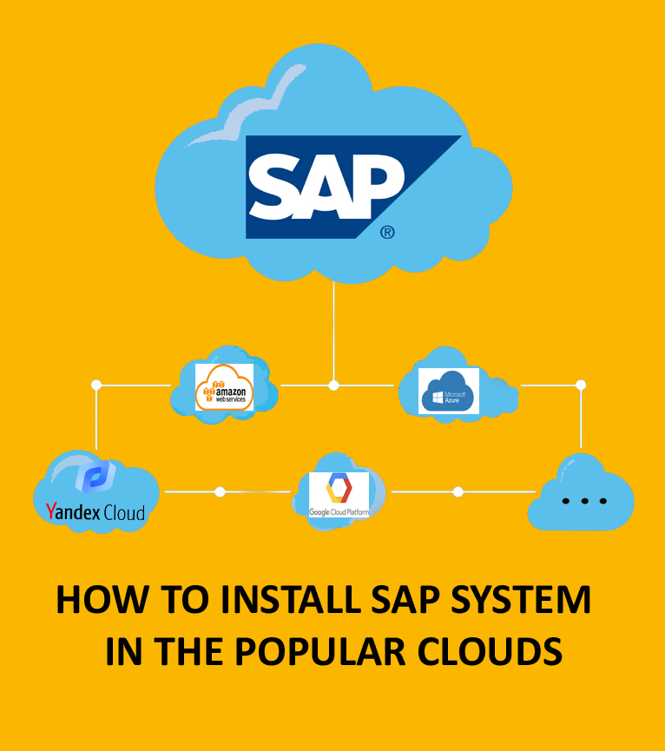
HOW TO INSTALL YOUR OWN SAP SYSTEM IN THE POPULAR CLOUDS

Slide 2


HOW TO INSTALL YOUR OWN SAP SYSTEM IN THE POPULAR CLOUDS
Roman Gorbenko: SAP BASIS / SAP EWM Consultant in
a leading pharmaceutical companу.
Сertified by SAP, AlibabaCloud and Linux Foundation
“AI”(woman voice): Artificial Intelligence. Voice interface, read speaker

Slide 3
HOW TO INSTALL YOUR OWN SAP SYSTEM IN THE POPULAR CLOUDS
About Course
This course provides hands-on step-by-step experience how to install and run SAP NetWeaver Application Server ABAP 7.5X Developer Edition in the popular clouds. You can explore it and learn how to develop modern ABAP applications with core data services and SAPUI5 or you can get an overview of SAP’s client / server technology, SAP BI and BW, SAP Basis technology and many more SAP topics.

Slide 4
HOW TO INSTALL YOUR OWN SAP SYSTEM IN THE POPULAR CLOUDS
Course Agenda
1. Target Audience
2. Course Requirements
3. About SAP HANA
4. What benefits you will get after installation of own SAP system?
5. Become SAP ABAP Developer
5.1. ABAP Exams, Books, Courses, Tutorials, and vacancy overview
5.2. [VIDEO] Become SAP ABAP Developer. Small demo
6. Become SAP BI/BW Developer
6.1. SAP BI/BW Exams, Books, Courses, Tutorials, and vacancy overview
6.2. [VIDEO] Become SAP BI/BW Developer. Small demo
7. Become FIORI / WEB / UI5 Developer
7.1. SAP FIORI Exams, Books, Courses, Tutorials, and vacancy overview
7.2. [VIDEO] Become SAP FIORI Developer. Small demo

Slide 5
HOW TO INSTALL YOUR OWN SAP SYSTEM IN THE POPULAR CLOUDS
Course Agenda
8. Become SAP BASIS Administrator
8.1. SAP BASIS Exams, Books, Courses, Tutorials, and vacancy overview
8.2. [VIDEO] Become SAP BASIS Administrator. Small demo
9. Tools overview
9.1. [VIDEO] Tools overview
10.Where you can install your own SAP system?
11. Amazon AWS
11.1. [VIDEO] Amazon AWS. Small demo
11.2. [VIDEO] Installation process in Amazon AWS
11.2. [VIDEO] Become SAP ABAP Developer. Extended example in Amazon AWS
12. Google Cloud Platform
12.1. [VIDEO] Google Cloud Platform. Small demo
12.2. [VIDEO] Installation process in Google Cloud Platform
12.2. [VIDEO] Become SAP ABAP Developer. Extended example in GCP

Slide 6
HOW TO INSTALL YOUR OWN SAP SYSTEM IN THE POPULAR CLOUDS
Course Agenda
13. Yandex Cloud
13.1. [VIDEO] Yandex Cloud. Small demo
13.2. [VIDEO] Installation process in Yandex Cloud
13.3. [VIDEO] Become SAP FIORI Developer. Extended example in Yandex Cloud
14. Microsoft Azure
14.1. [VIDEO] Microsoft Azure. Small demo
14.2. [VIDEO] Installation process in Microsoft Azure
14.3. [VIDEO] Become SAP BASIS Administrator. Extended example in Microsoft Azure
15. Conclusion

Slide 7
HOW TO INSTALL YOUR OWN SAP SYSTEM IN THE POPULAR CLOUDS
Target Audience
Anyone who wants to learn SAP ABAP language on practice in your own SAP System with all ABAP development tools
Anyone who wants to learn SAP Fiori / UX Design in your own preconfigured SAP system
Anyone who wants to learn SAP BI/BW in your own preconfigured SAP system
Anyone who wants to learn SAP Basis in your own SAP system
Anyone who wants to become a cloud practitioner in the most popular clouds from Amazon, Google, Microsoft and Yandex
If you are already an SAP Developer or SAP Functional Consultant basically at work you have restricted access to the system. Your own SAP System brings to you a new level of freedom.
How does this course will be useful to me?
Small demo (ABAP, BW, FIORI, BASIS) of the course open for preview. You can make sure that this system is suitable for your training. Please go through it before you buy this course.

Slide 8
HOW TO INSTALL YOUR OWN SAP SYSTEM IN THE POPULAR CLOUDS
Course Requirements
The requirements for the course are quite low - follow the video lectures.
You just need (but is not mandatory) a basic understanding in SAP, basic knowledge in Linux, and Windows operation systems. Ideally: you work / study SAP and wanting to learnt more at home in your own SAP system with full rights (SAP_ALL profile) .
In short, the course is good for anyone wanting to learn more about SAP Basis, SAP Development and Cloud Technologies on practice.
You can find a lot of separate courses about SAP ABAP, UX-design, SAP BASIS and FIORI (Links provided). This course about the installation of your own SAP System. Provided development examples exist to show that an installed system can be used for educational purposes.
All cloud providers from this course give credit to new users.
Hence this is enough to try the service without any charges from your credit card.

Slide 9
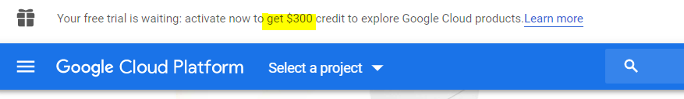
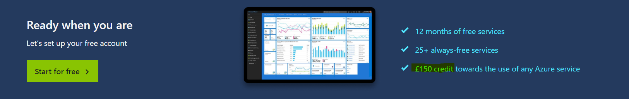
HOW TO INSTALL YOUR OWN SAP SYSTEM IN THE POPULAR CLOUDS
Course Requirements
Free trial. Example for GCP.
Free trial. Example for Microsoft Azure.

Slide 10
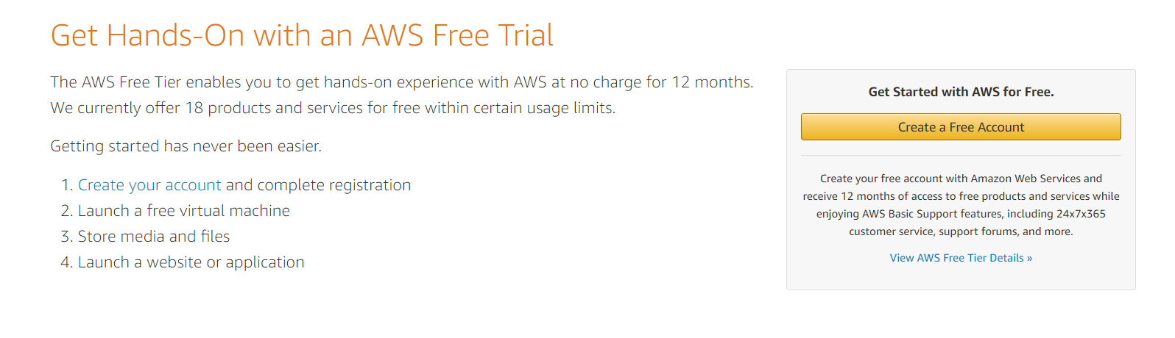
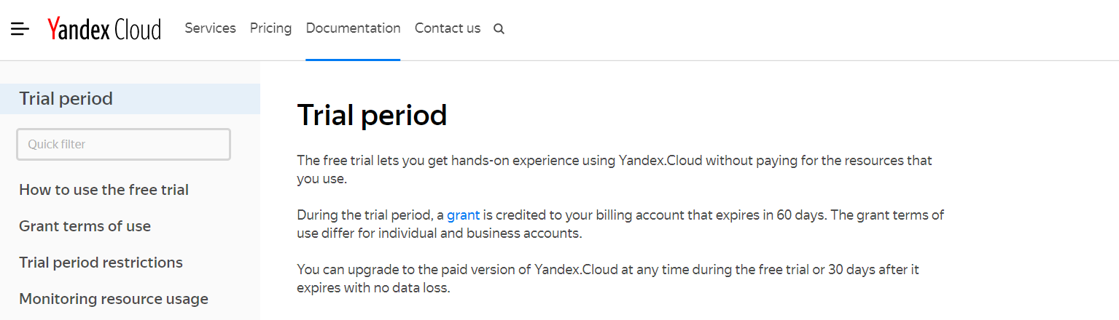
HOW TO INSTALL YOUR OWN SAP SYSTEM IN THE POPULAR CLOUDS
Course Requirements
Free trial. Example for AWS.
Free trial. Example for Yandex Cloud.

Slide 11
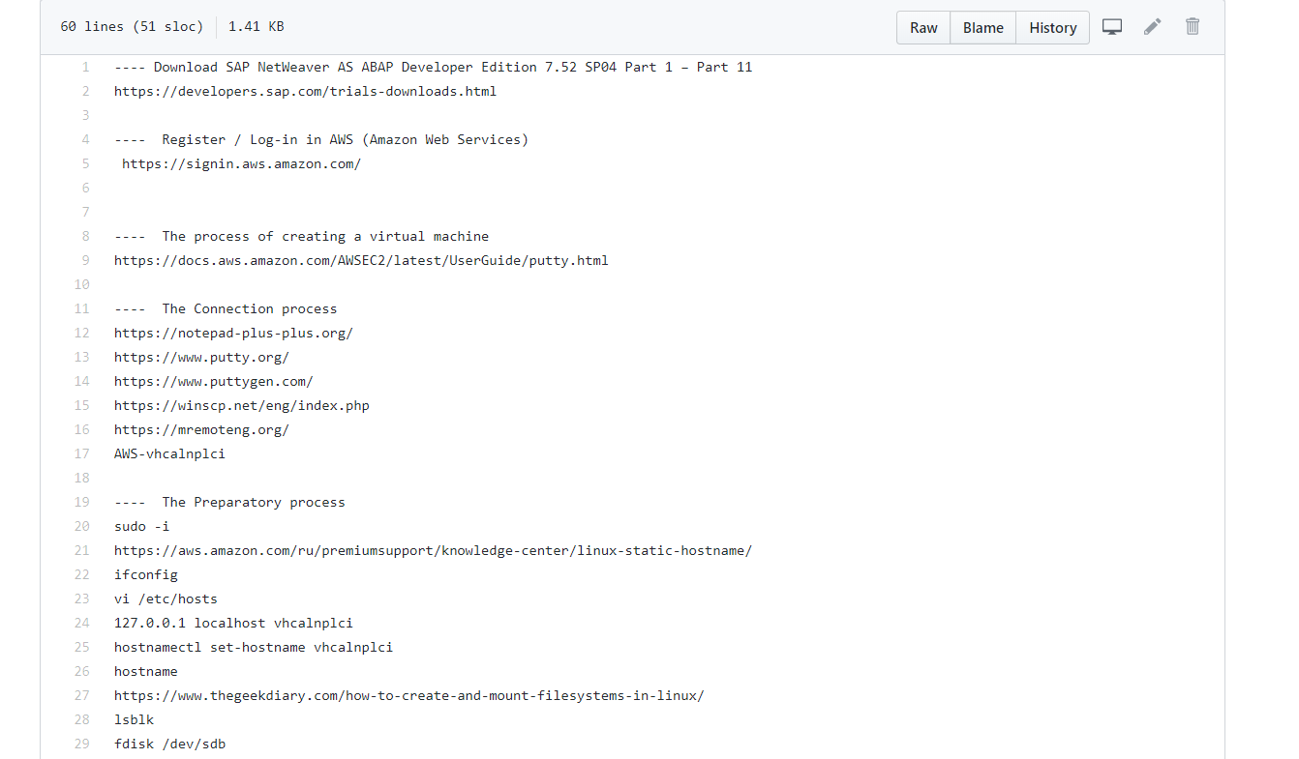
HOW TO INSTALL YOUR OWN SAP SYSTEM IN THE POPULAR CLOUDS
Course Requirements
You can find code samples, datasets, Linux commands, links at GitHub repo of this course
https://github.com/basisteam-io/BasisTeam-Content/tree/master/edu/sap_nw_in_cloud

Slide 12
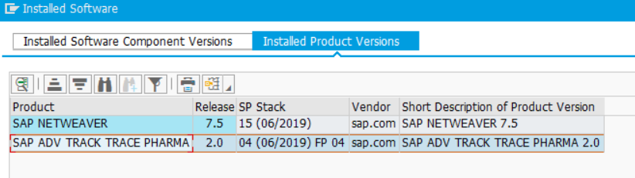
HOW TO INSTALL YOUR OWN SAP SYSTEM IN THE POPULAR CLOUDS
About SAP NetWeaver
SAP NetWeaver is a technology of the SAP company, and the technical foundation for many SAP applications. It is a solution stack of SAP's technology products.
For example. SAP NetWeaver X + Add-On SAP EWM X = SAP EWM -> Powerful and widespread Warehouse Management System (WMS) which is used by such large companies such as Ford, Danone, UPS, BMW and thousand others
or
SAP NetWeaver X + Add-On ADV TRACK TRACE PHARMA X = SAP ATTP -> Niche product which allows pharmaceutical companies report serial number events to authorities and business partners, enabling compliance to international legislation
SAP ATTP

Slide 13

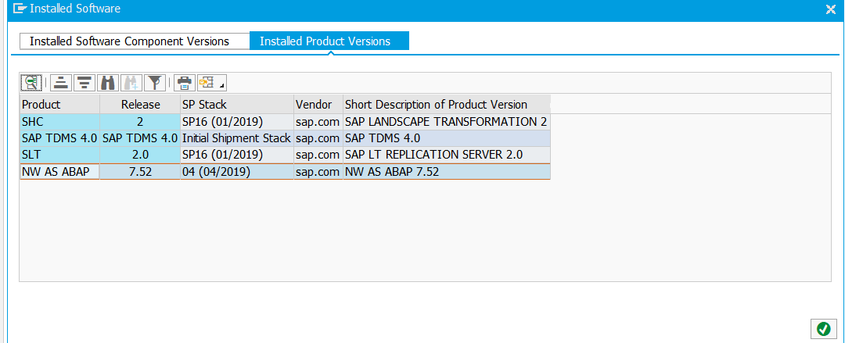
HOW TO INSTALL YOUR OWN SAP SYSTEM IN THE POPULAR CLOUDS
About SAP NetWeaver
Widespread SAP EWM, SAP TM and so on or niche SAP ATTP or SAP Developer Edition from this course they have the same foundation – NetWeaver
SAP Developer Edition from this course

Slide 14
HOW TO INSTALL YOUR OWN SAP SYSTEM IN THE POPULAR CLOUDS
What benefits you will get after installation of own SAP system?
You can:
Become
ABAP DEV
Become
SAP BASIS
…
Become
FIORI DEV
Become
BW DEV

Slide 15

HOW TO INSTALL YOUR OWN SAP SYSTEM IN THE POPULAR CLOUDS
Become SAP ABAP Developer

Slide 16
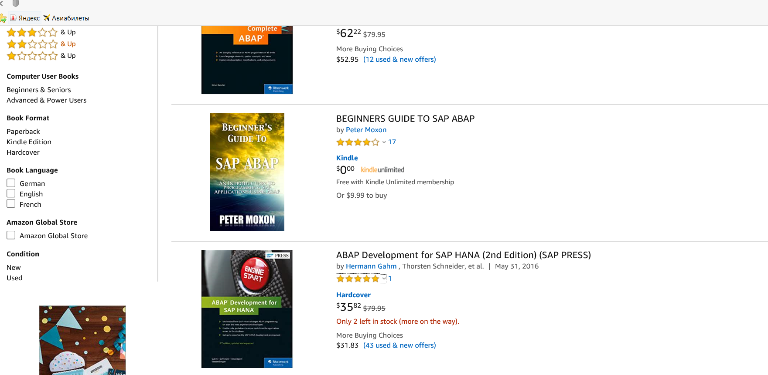
HOW TO INSTALL YOUR OWN SAP SYSTEM IN THE POPULAR CLOUDS
Become SAP ABAP Developer
Books* and hands-on exercises in your own SAP system
- https://www.amazon.com/s?k=SAP+ABAP&ref=nb_sb_noss_2

Slide 17
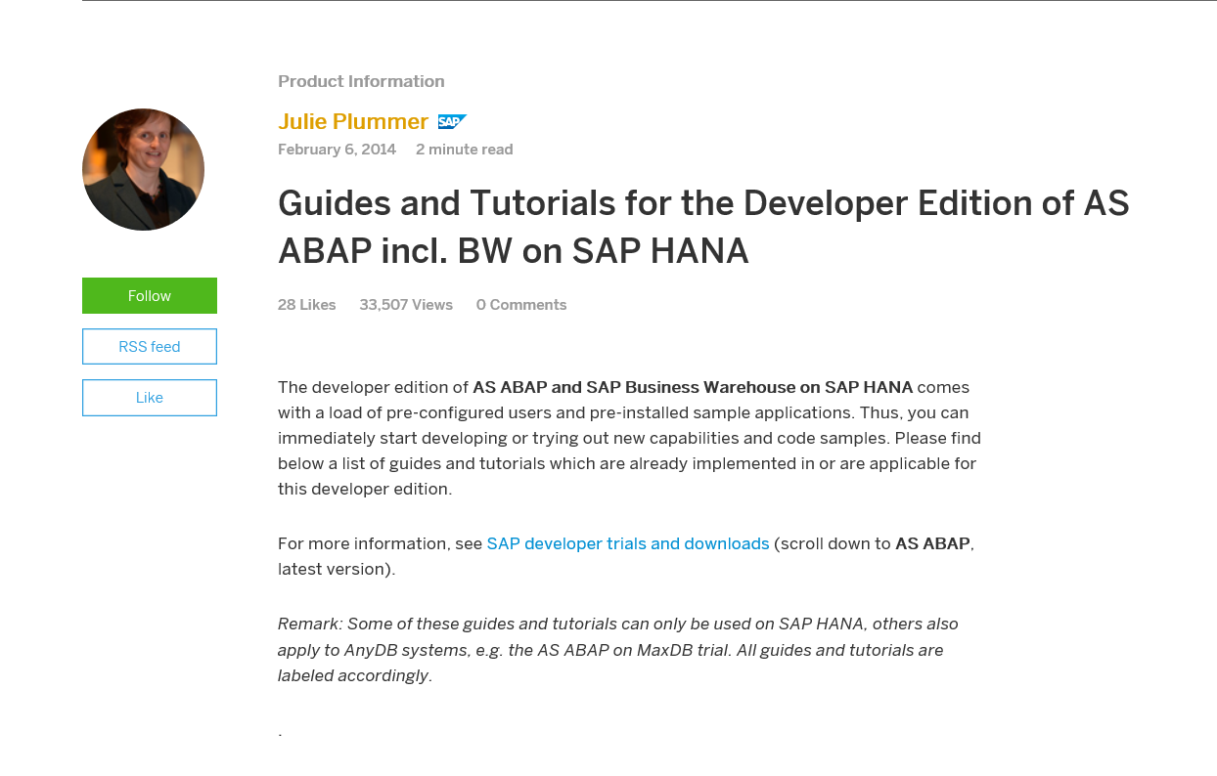
HOW TO INSTALL YOUR OWN SAP SYSTEM IN THE POPULAR CLOUDS
Become SAP ABAP Developer
Guides, Tutorials* and hands-on exercises in your own SAP system
* - https://blogs.sap.com/2014/02/06/guides-and-tutorials-for-the-developer-edition-of-as-abap-incl-bw-on-sap-hana/

Slide 18
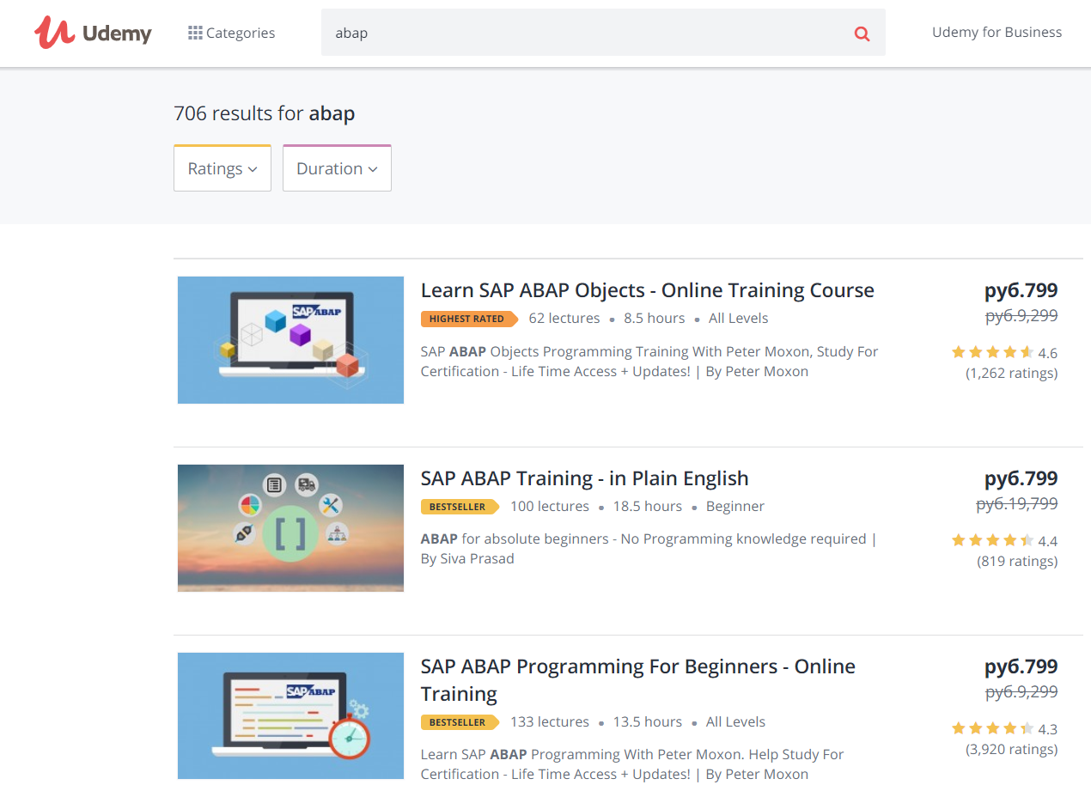
HOW TO INSTALL YOUR OWN SAP SYSTEM IN THE POPULAR CLOUDS
Become SAP ABAP Developer
Udemy courses* and hands-on exercises in your own SAP system
* - https://www.udemy.com/courses/search/?src=ukw&q=ABAP

Slide 19
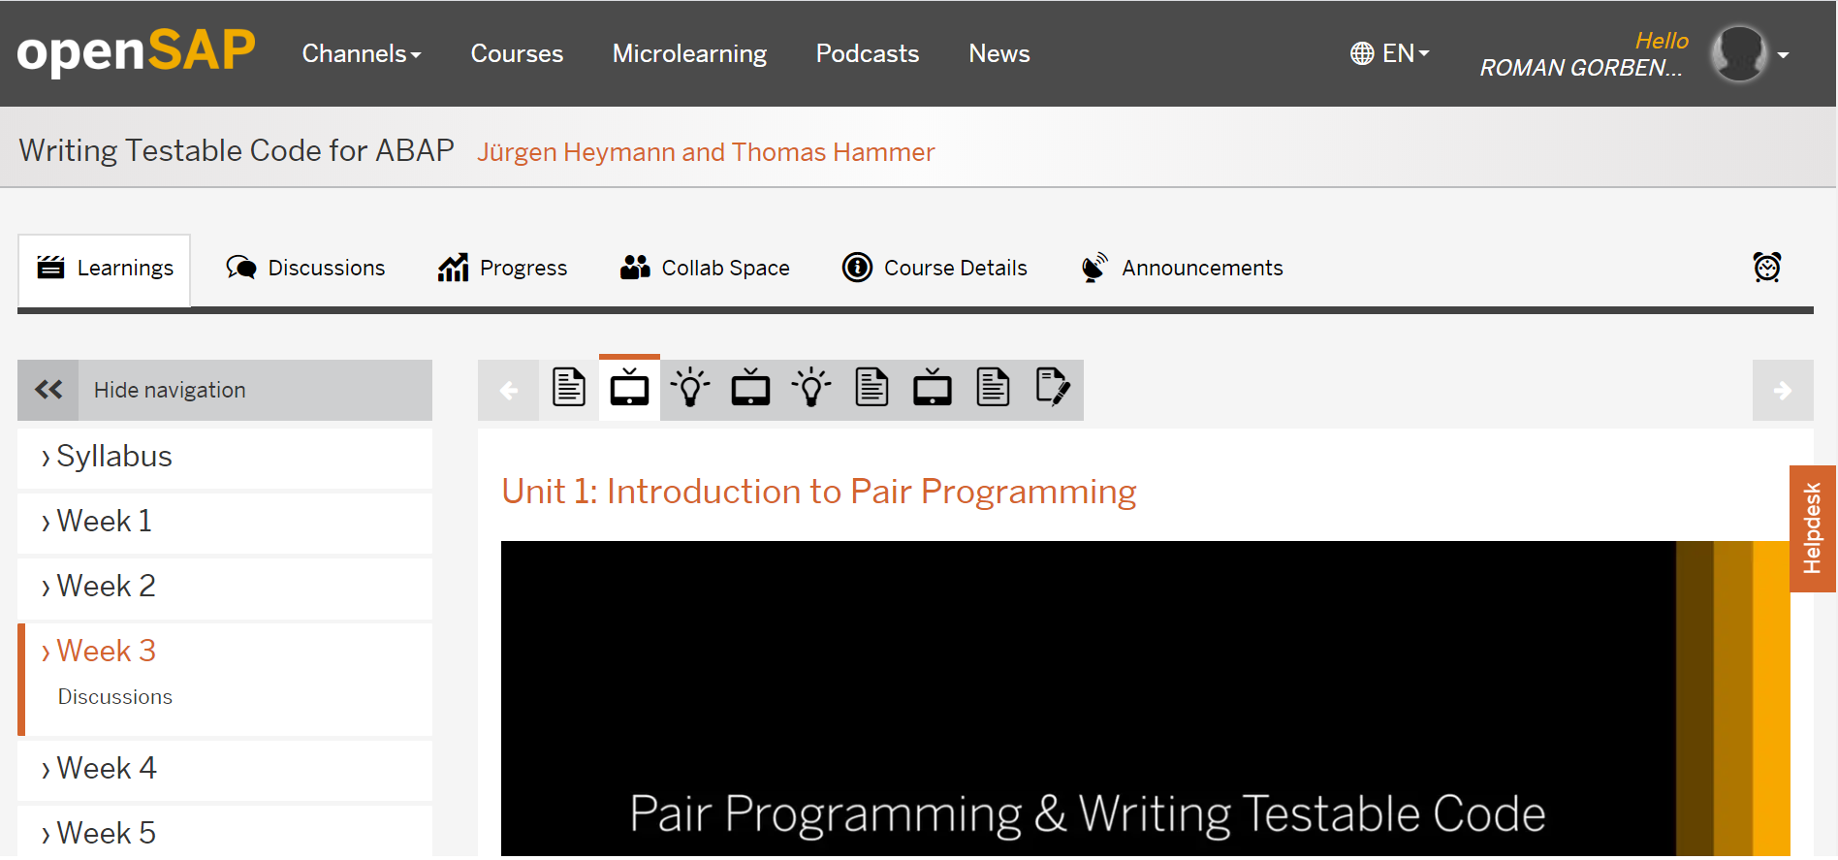
HOW TO INSTALL YOUR OWN SAP SYSTEM IN THE POPULAR CLOUDS
Become SAP ABAP Developer
openSAP courses* and hands-on exercises in your own SAP system
- https://open.sap.com/courses/wtc1

Slide 20
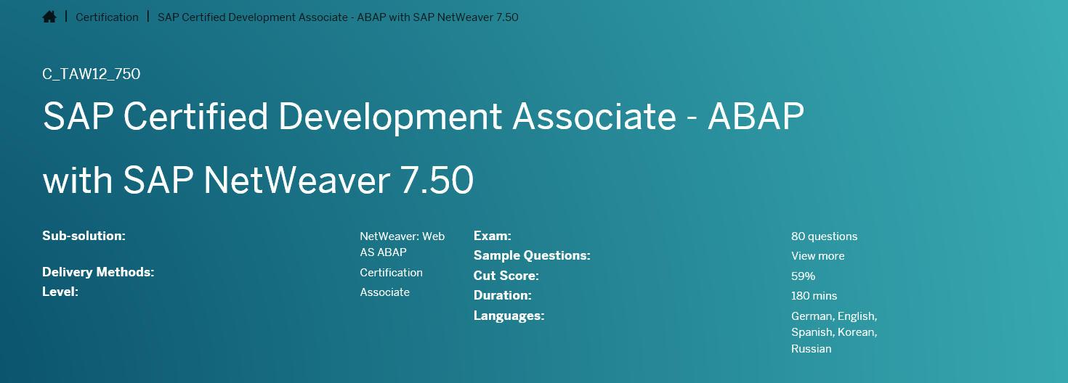
HOW TO INSTALL YOUR OWN SAP SYSTEM IN THE POPULAR CLOUDS
Become SAP ABAP Developer
To make your SAP ABAP 7.5 Certification Exam * ( for example: C_TAW12_750) preparation easy with hands-on exercises in your own SAP system with ABAP Editor
- https://training.sap.com/certification/c_taw12_750-sap-certified-development-associate---abap-with-sap-netweaver-750-g/

Slide 21
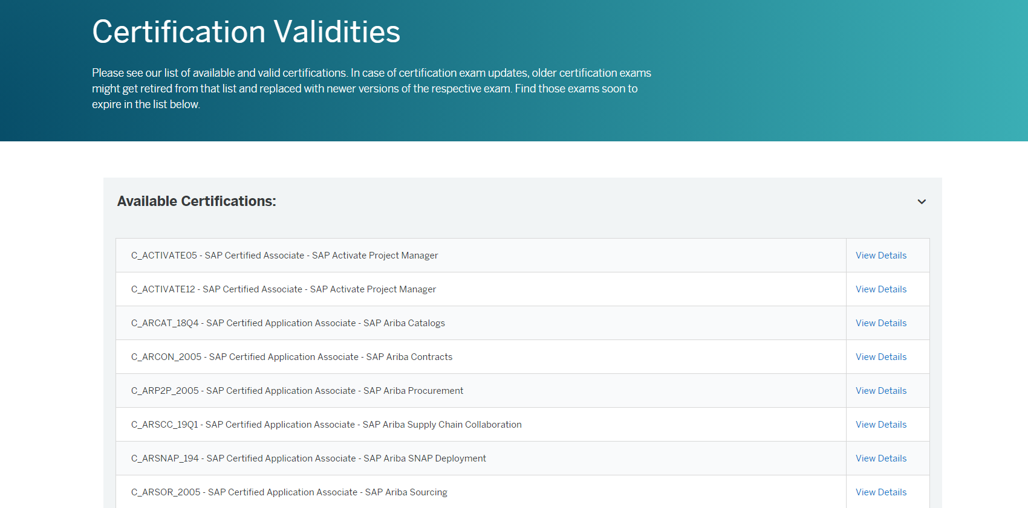
HOW TO INSTALL YOUR OWN SAP SYSTEM IN THE POPULAR CLOUDS
Become SAP ABAP Developer
To make your SAP ABAP Dev Certification Exam (List of all possible certificates*)
- https://training.sap.com/certification/validity

Slide 22
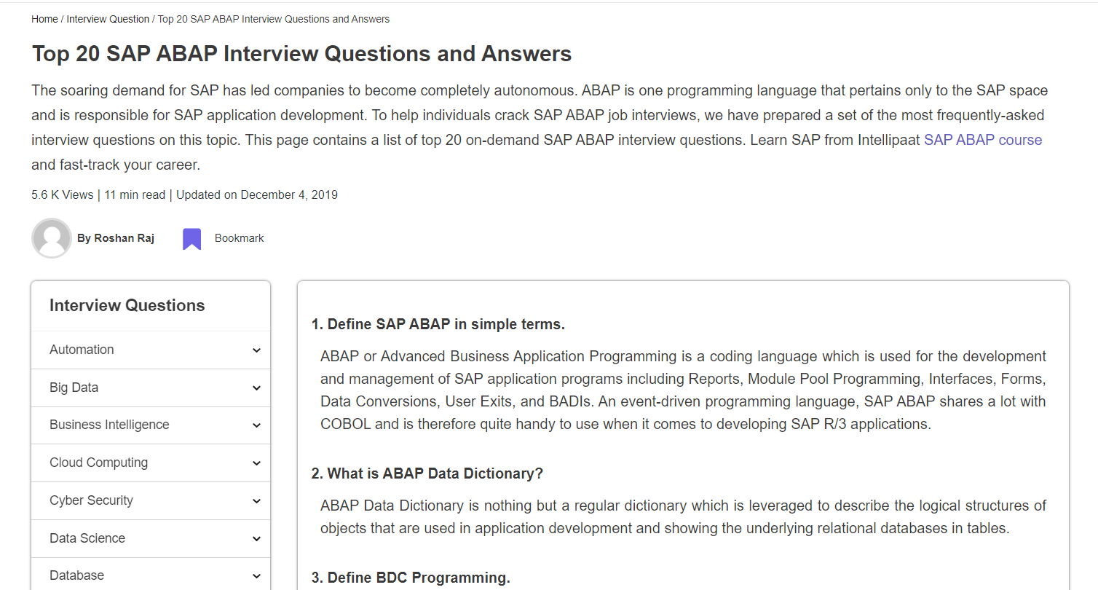
HOW TO INSTALL YOUR OWN SAP SYSTEM IN THE POPULAR CLOUDS
Become SAP ABAP Developer
Prepare for the Job-interview* in your own SAP system
* - https://intellipaat.com/blog/interview-question/sap-abap-interview-questions/

Slide 23
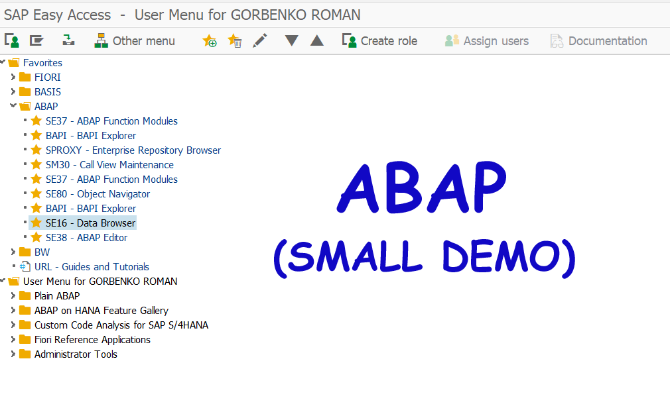

HOW TO INSTALL YOUR OWN SAP SYSTEM IN THE POPULAR CLOUDS
Become ABAP Developer

Slide 24
HOW TO INSTALL YOUR OWN SAP SYSTEM IN THE POPULAR CLOUDS
Become ABAP Developer.
Key transactions from video.
SE38 - ABAP Editor
SFP – Form Builder
SE80 - Object Navigator
ATC - ABAP Test Cockpit
SE16 - Data Browser
SE11 - ABAP Dictionary Maintenance
SPROXY - Enterprise Repository Browser
SE37 - ABAP Function Modules
BAPI - BAPI Explorer
SE10 - Transport Organizer
SM30 – Call View Maintenance
SREPO - Compare objects between systems

Slide 25
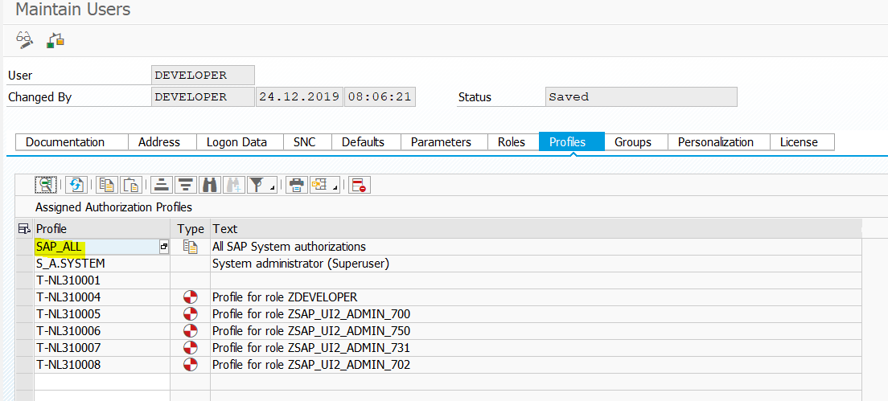
HOW TO INSTALL YOUR OWN SAP SYSTEM IN THE POPULAR CLOUDS
Key benefits: It is your own SAP system and you have a full (SAP_ALL) rights for your development process
Look at more ABAP examples after SAP system installation in AWS cloud. See you there!

Slide 26

HOW TO INSTALL YOUR OWN SAP SYSTEM IN THE POPULAR CLOUDS
Become SAP BI / BW Developer

Slide 27
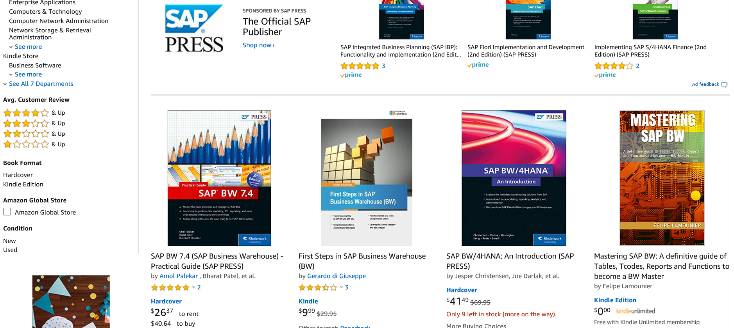
HOW TO INSTALL YOUR OWN SAP SYSTEM IN THE POPULAR CLOUDS
Become SAP BI / BW Developer
Books* and hands-on exercises in your own SAP system
- https://www.amazon.com/s?k=SAP+BW&ref=nb_sb_noss_2

Slide 28
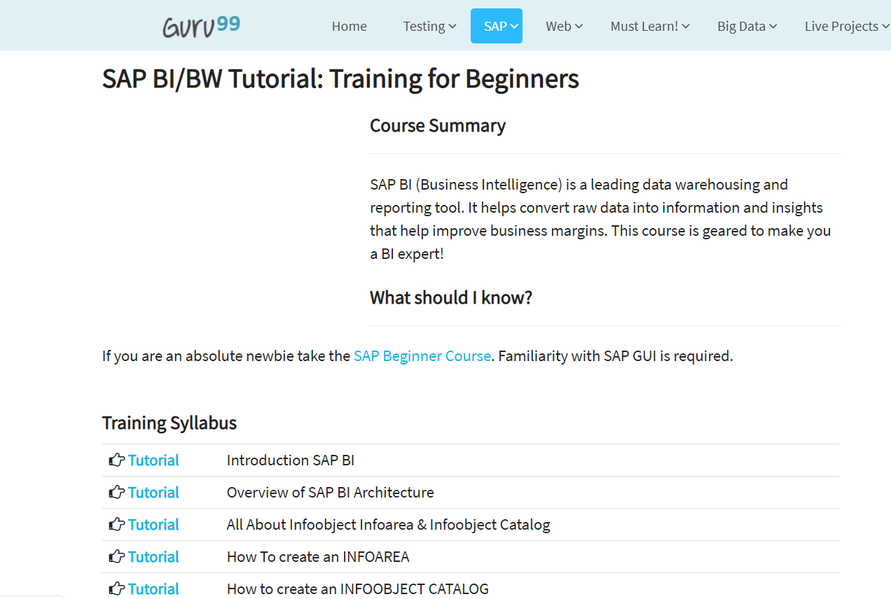
HOW TO INSTALL YOUR OWN SAP SYSTEM IN THE POPULAR CLOUDS
Become SAP BI / BW Developer
Guides, Tutorials* and hands-on exercises in your own SAP system
* - https://www.guru99.com/sap-bi.html

Slide 29
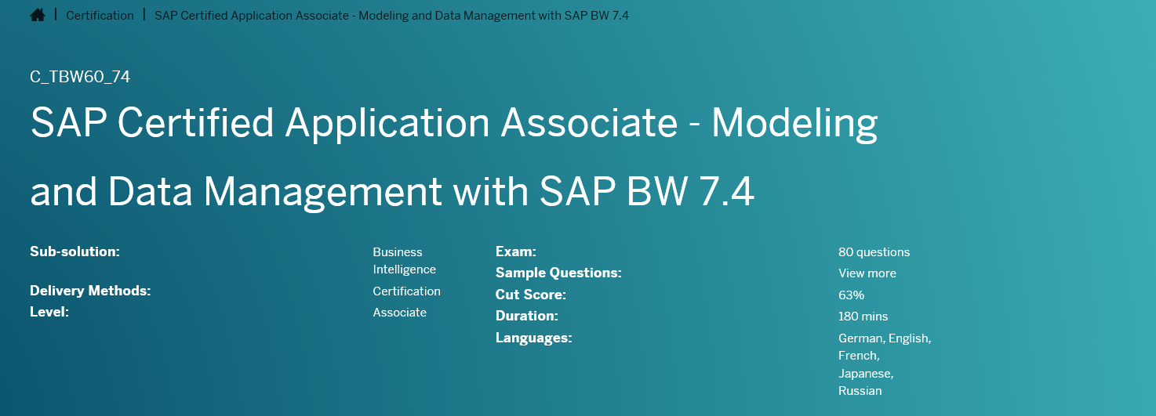
HOW TO INSTALL YOUR OWN SAP SYSTEM IN THE POPULAR CLOUDS
Become SAP BI / BW Developer.
To make your SAP Modeling and Data Management with BW* (C_TBW60_74) preparation easy with hands-on exercises in your own SAP system with Data Warehousing Workbench
- https://training.sap.com/certification/c_tbw60_74-sap-certified-application-associate---modeling-and-data-management-with-sap-bw-74-g/

Slide 30
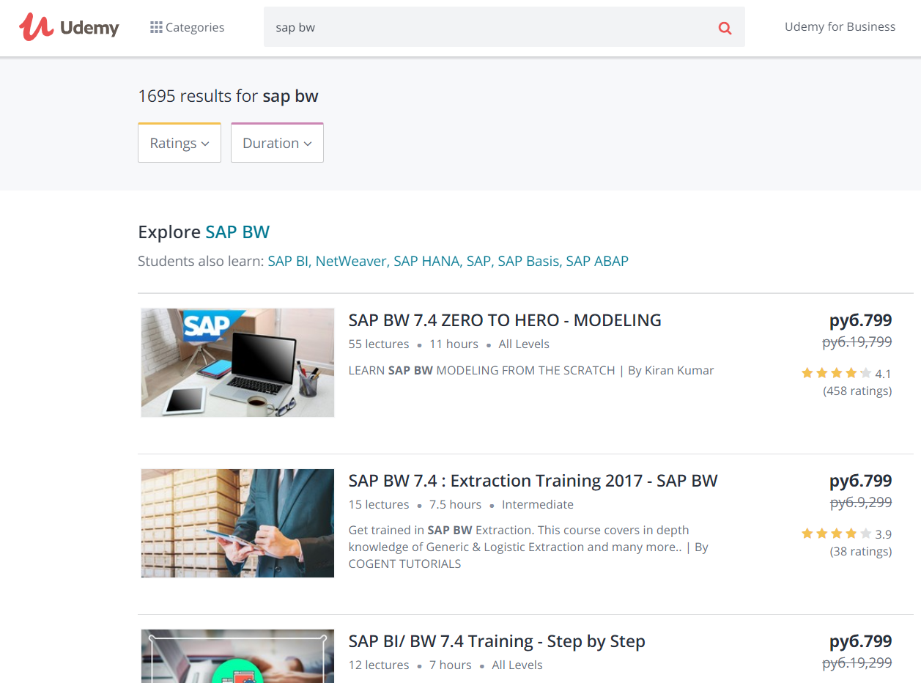
HOW TO INSTALL YOUR OWN SAP SYSTEM IN THE POPULAR CLOUDS
Become SAP BI / BW Developer
Udemy courses* and hands-on exercises in your own SAP system
* - https://www.udemy.com/courses/search/?src=ukw&q=sap%20bw

Slide 31
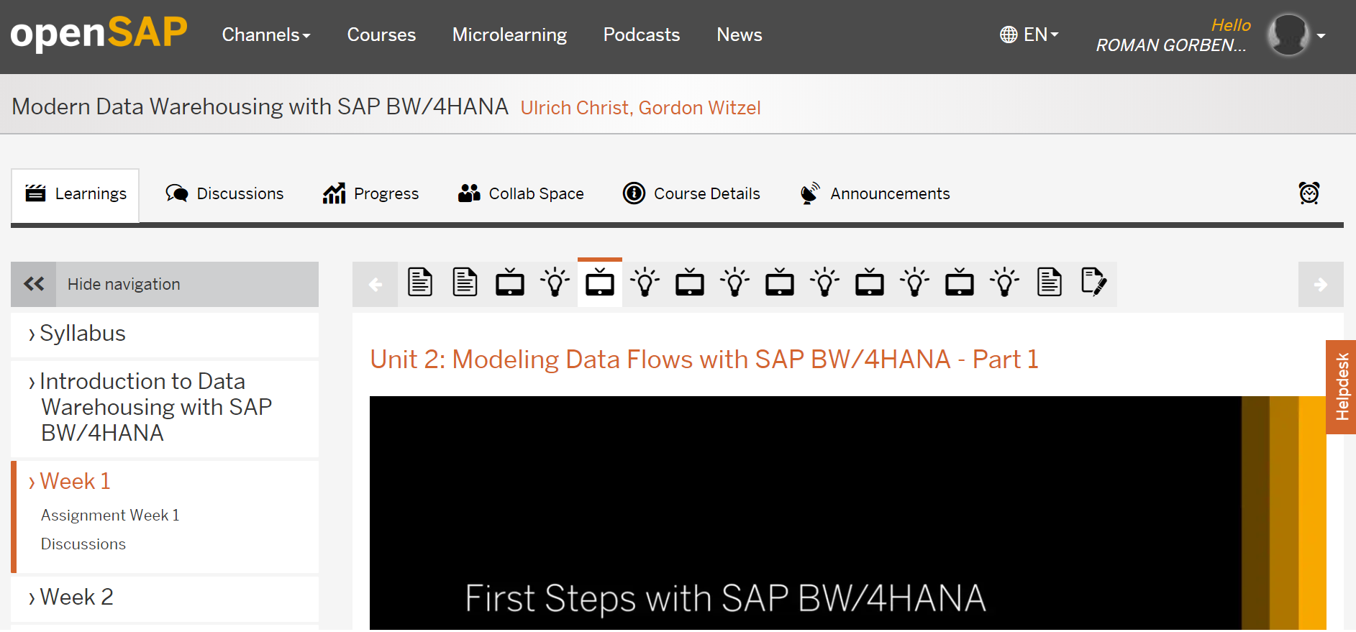
HOW TO INSTALL YOUR OWN SAP SYSTEM IN THE POPULAR CLOUDS
Become SAP BI / BW Developer
openSAP courses* and hands-on exercises in your own SAP system
* - https://open.sap.com/courses/bw4h2/overview

Slide 32
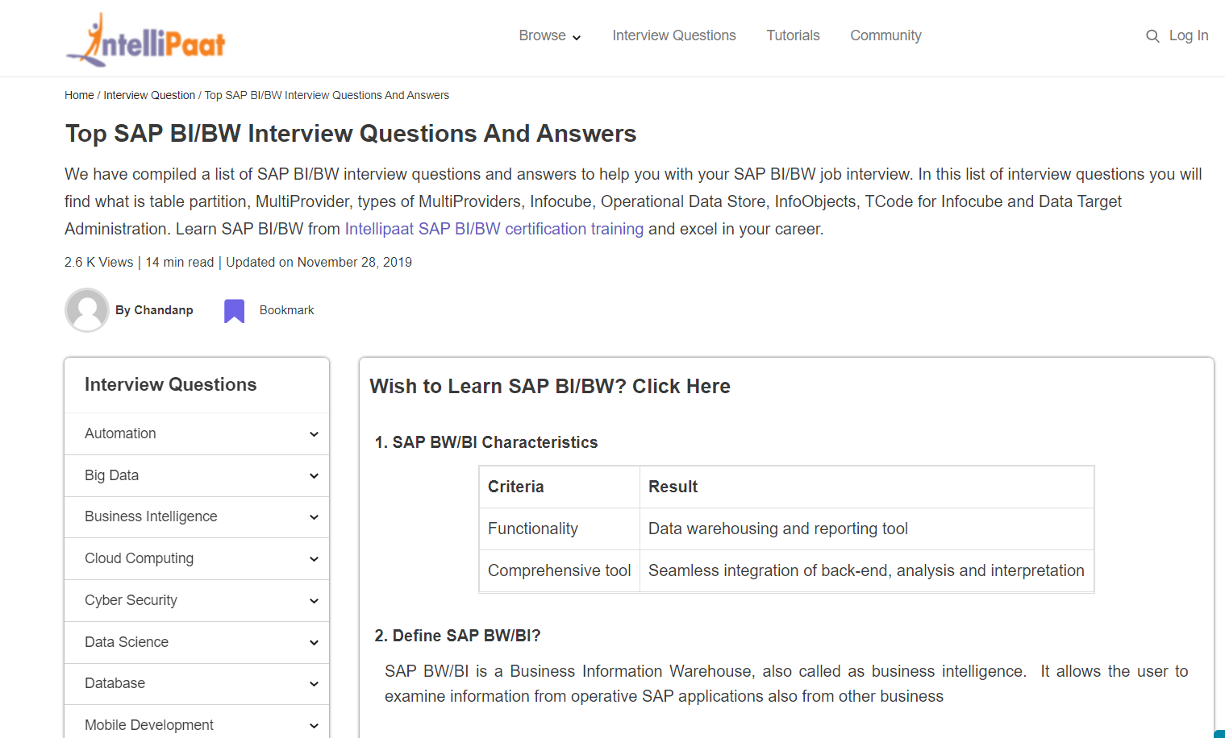
HOW TO INSTALL YOUR OWN SAP SYSTEM IN THE POPULAR CLOUDS
Become SAP BI / BW Developer
Prepare for the Job-interview* in your own SAP system
* - https://intellipaat.com/blog/interview-question/sap-bibw-interview-questions/

Slide 33
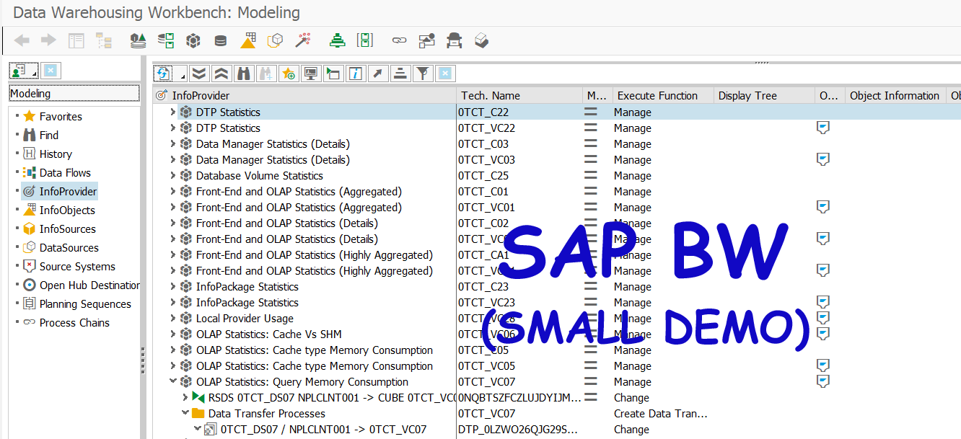
HOW TO INSTALL YOUR OWN SAP SYSTEM IN THE POPULAR CLOUDS
Become SAP BI/BW Developer

Slide 34
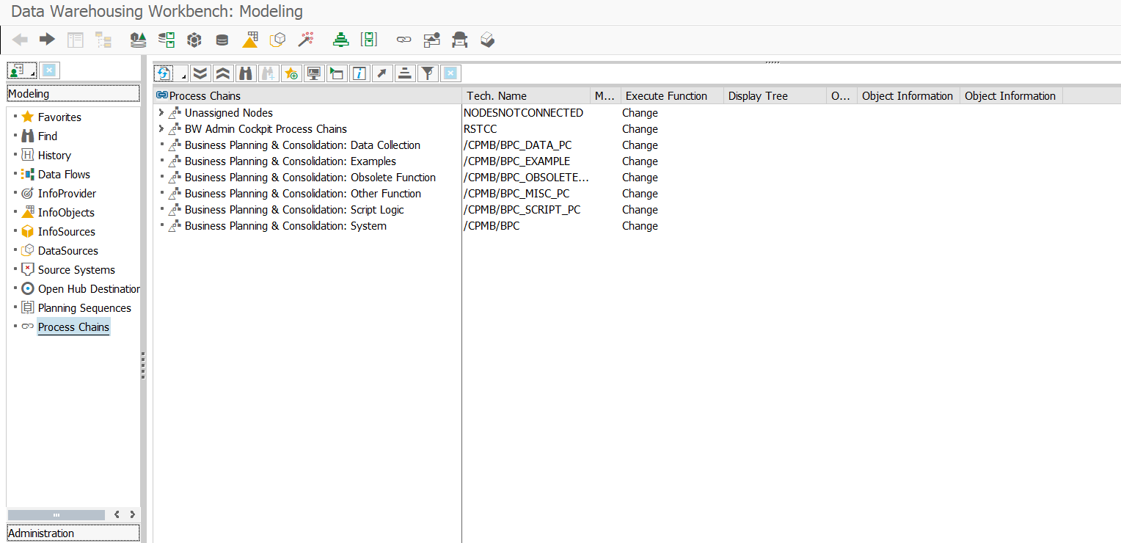
HOW TO INSTALL YOUR OWN SAP SYSTEM IN THE POPULAR CLOUDS
Become SAP BI/BW Developer.
Key transactions from video.
RSA1 – Modeling – DW Workbench
RRMX – Start the Business Explorer Analyzer
RSECADMIN – Manage Analysis Authorizations
RSUDO – Execution as Other User

Slide 35
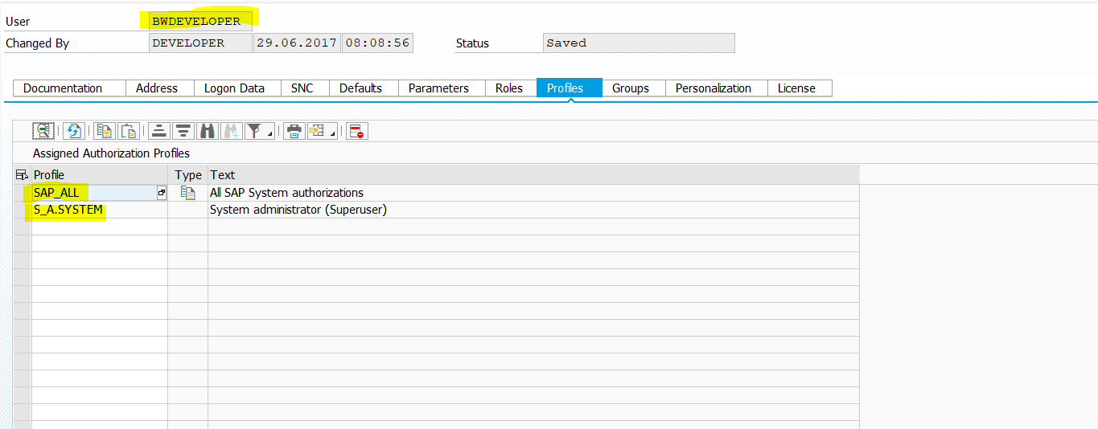
HOW TO INSTALL YOUR OWN SAP SYSTEM IN THE POPULAR CLOUDS
Key benefits: It is your own SAP system and you have a full (SAP_ALL) rights in it
Look at more BI/BW examples after SAP system installation in Google Cloud Platform. See you there!

Slide 36
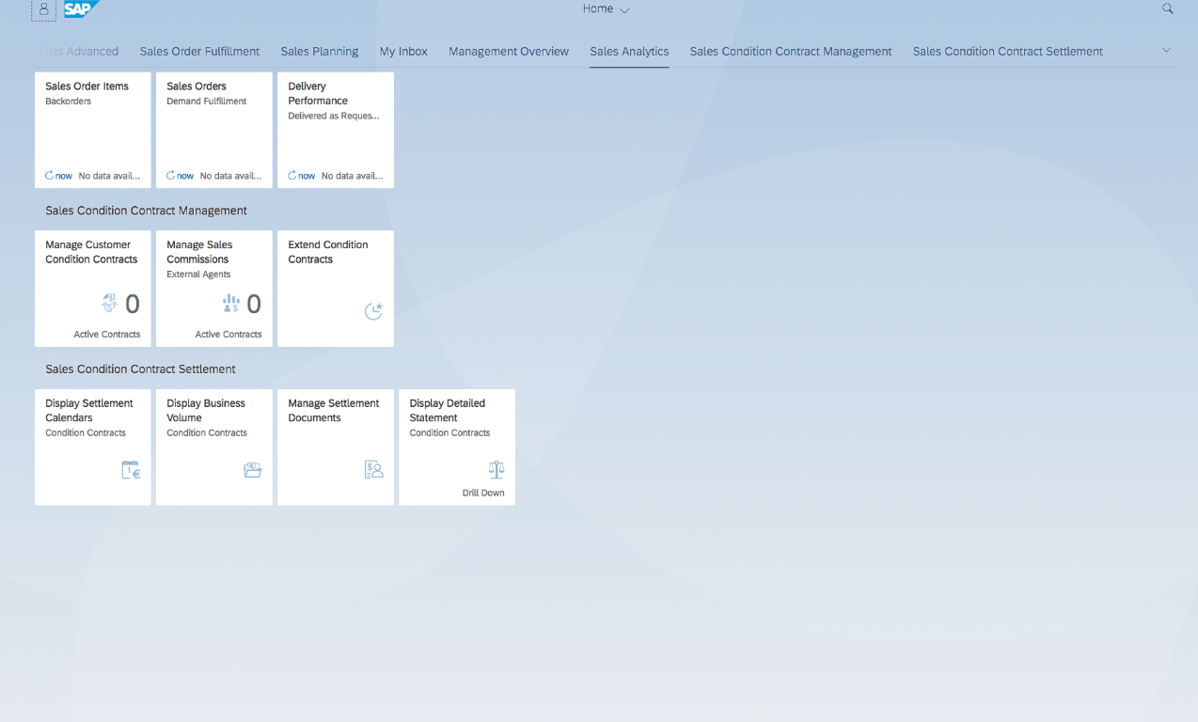
HOW TO INSTALL YOUR OWN SAP SYSTEM IN THE POPULAR CLOUDS
Become FIORI / WEB / UI5 Developer

Slide 37
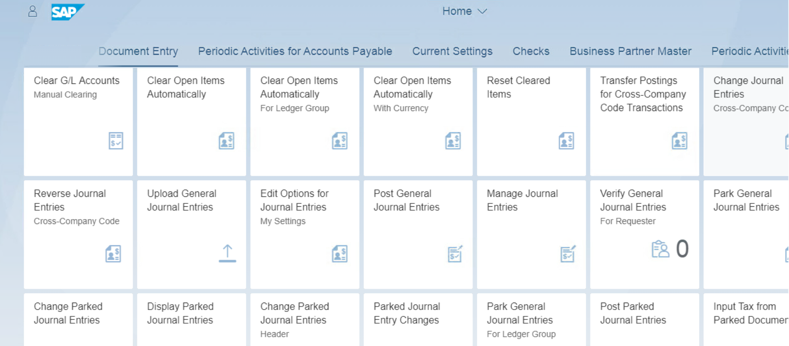
HOW TO INSTALL YOUR OWN SAP SYSTEM IN THE POPULAR CLOUDS
Become FIORI Developer. Fiori Launchpad examples.

Slide 38
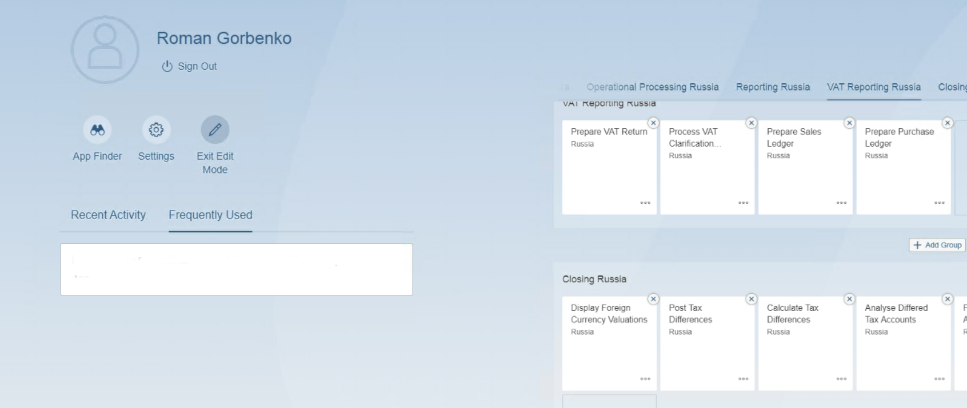
HOW TO INSTALL YOUR OWN SAP SYSTEM IN THE POPULAR CLOUDS
Become FIORI Developer. Fiori Launchpad examples.

Slide 39
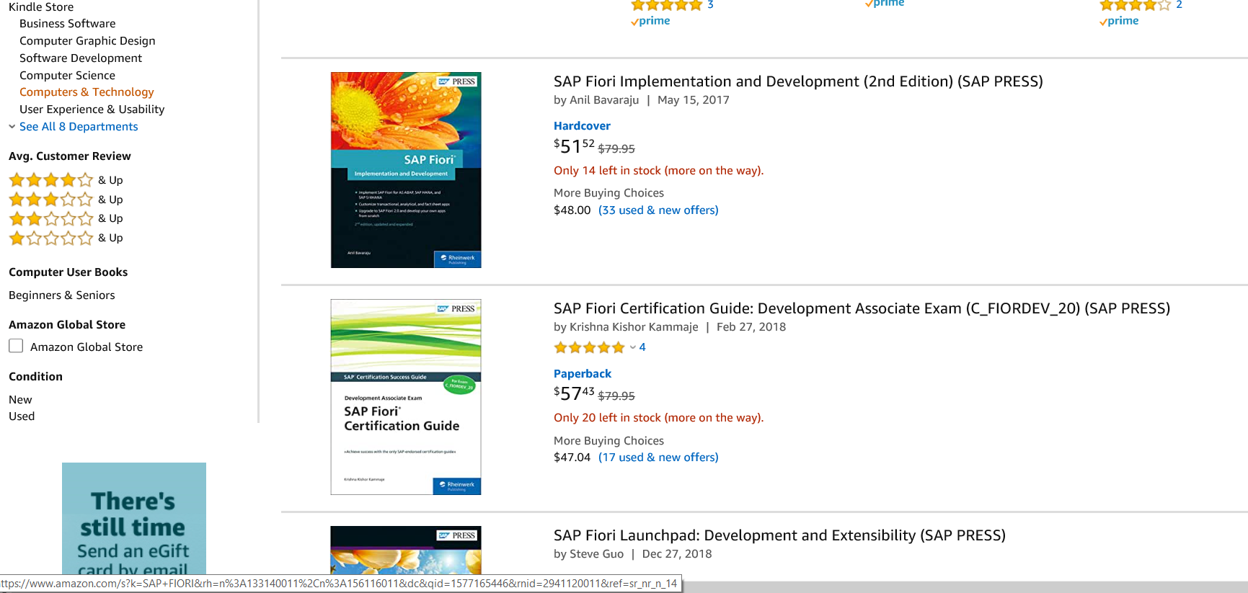
HOW TO INSTALL YOUR OWN SAP SYSTEM IN THE POPULAR CLOUDS
Become FIORI Developer. Books* and hands-on exercises in your own SAP system
- https://www.amazon.com/s?k=SAP+FIORI&ref=nb_sb_noss_2

Slide 40
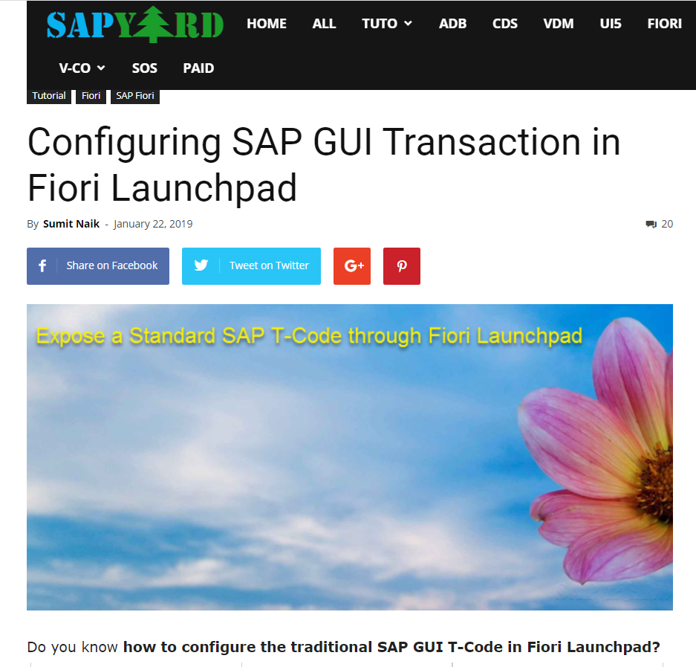
HOW TO INSTALL YOUR OWN SAP SYSTEM IN THE POPULAR CLOUDS
Become FIORI Developer. Guides, Tutorials* and hands-on exercises in your own SAP system
* - https://sapyard.com/configuring-sap-gui-transaction-in-fiori-launchpad/

Slide 41
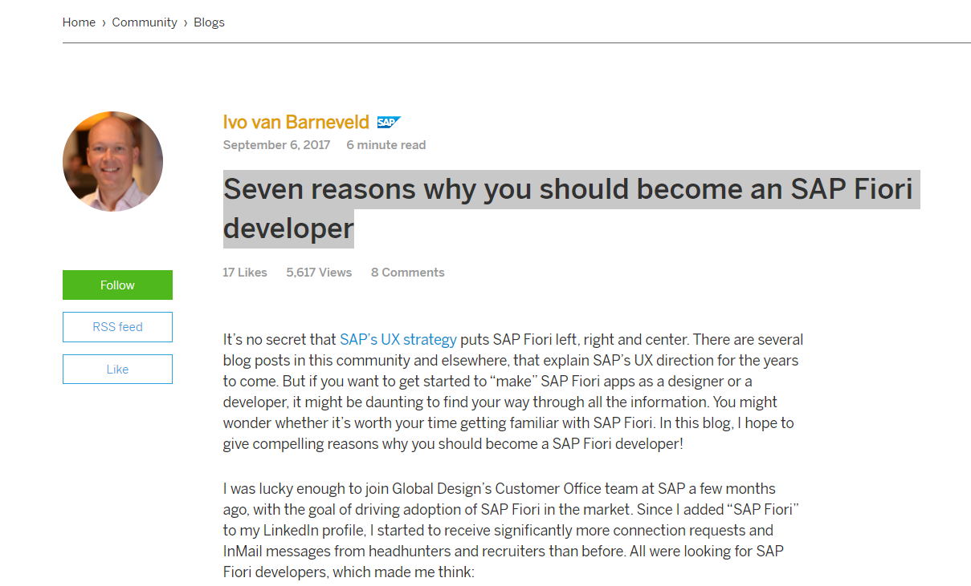
HOW TO INSTALL YOUR OWN SAP SYSTEM IN THE POPULAR CLOUDS
Become FIORI Developer. Guides, Tutorials* and hands-on exercises in your own SAP system: Seven reasons why you should become an SAP Fiori developer
* - https://blogs.sap.com/2017/09/06/seven-reasons-why-you-should-become-a-fiori-developer/

Slide 42
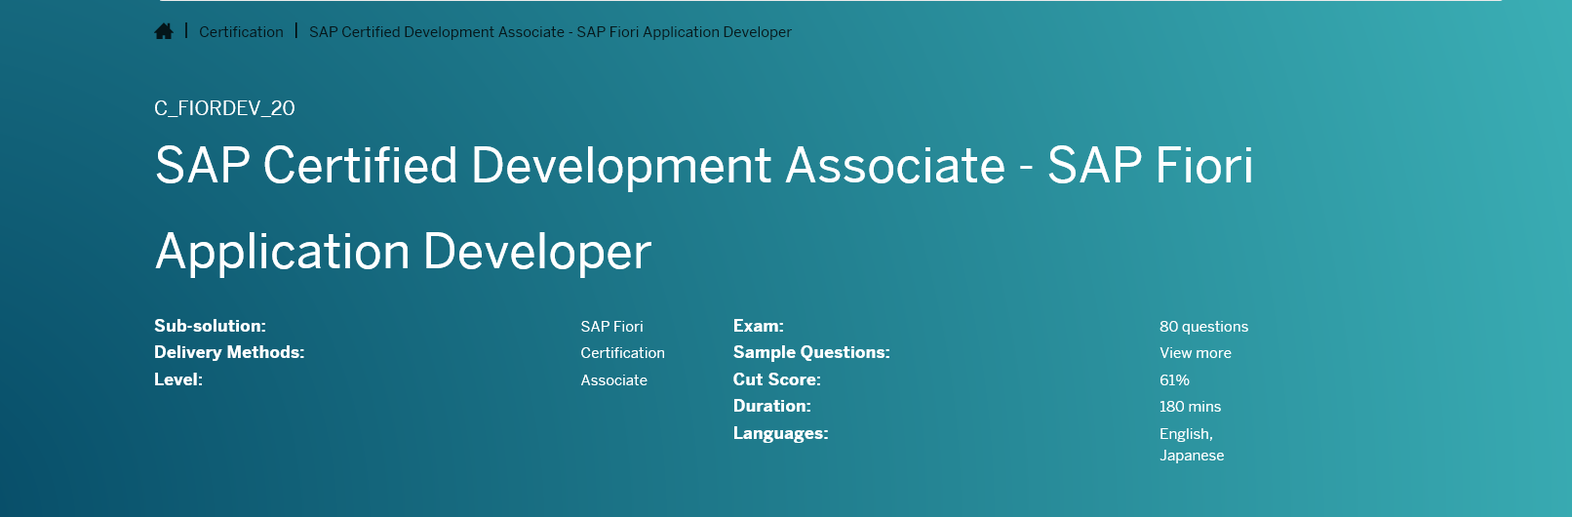
HOW TO INSTALL YOUR OWN SAP SYSTEM IN THE POPULAR CLOUDS
Become FIORI Developer. To make your SAP Fiori Application Developer Certification Exam* (C_FIORDEV_20) preparation easy with hands-on exercises in your own SAP system with Fiori
* - https://training.sap.com/certification/c_fiordev_20-sap-certified-development-associate---sap-fiori-application-developer-g/

Slide 43
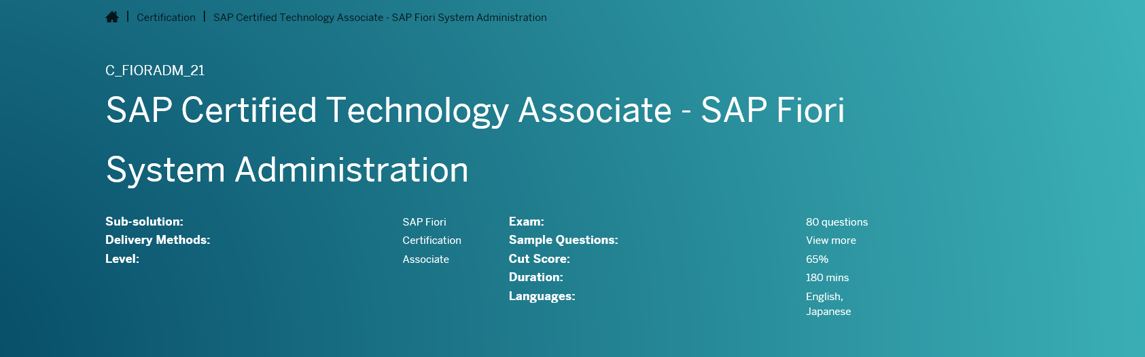
HOW TO INSTALL YOUR OWN SAP SYSTEM IN THE POPULAR CLOUDS
Become FIORI Developer. To make your SAP Fiori System Administration Certification Exam (C_FIORADM_21) preparation easy with hands-on exercises in your own SAP system with Fiori
* - https://training.sap.com/certification/c_fioradm_21-sap-certified-technology-associate---sap-fiori-system-administration-g/

Slide 44
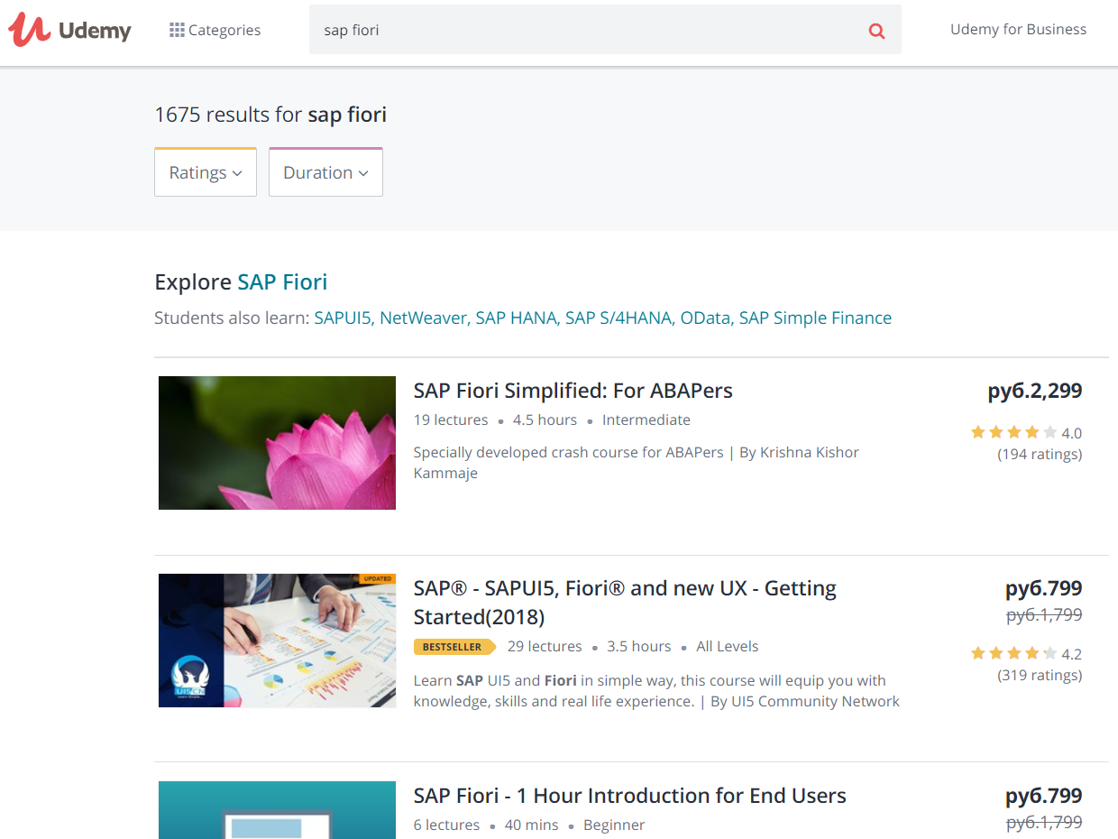
HOW TO INSTALL YOUR OWN SAP SYSTEM IN THE POPULAR CLOUDS
Become FIORI Developer. Udemy courses* and hands-on exercises in your own SAP system
* - https://www.udemy.com/courses/search/?src=ukw&q=sap%20fiori

Slide 45
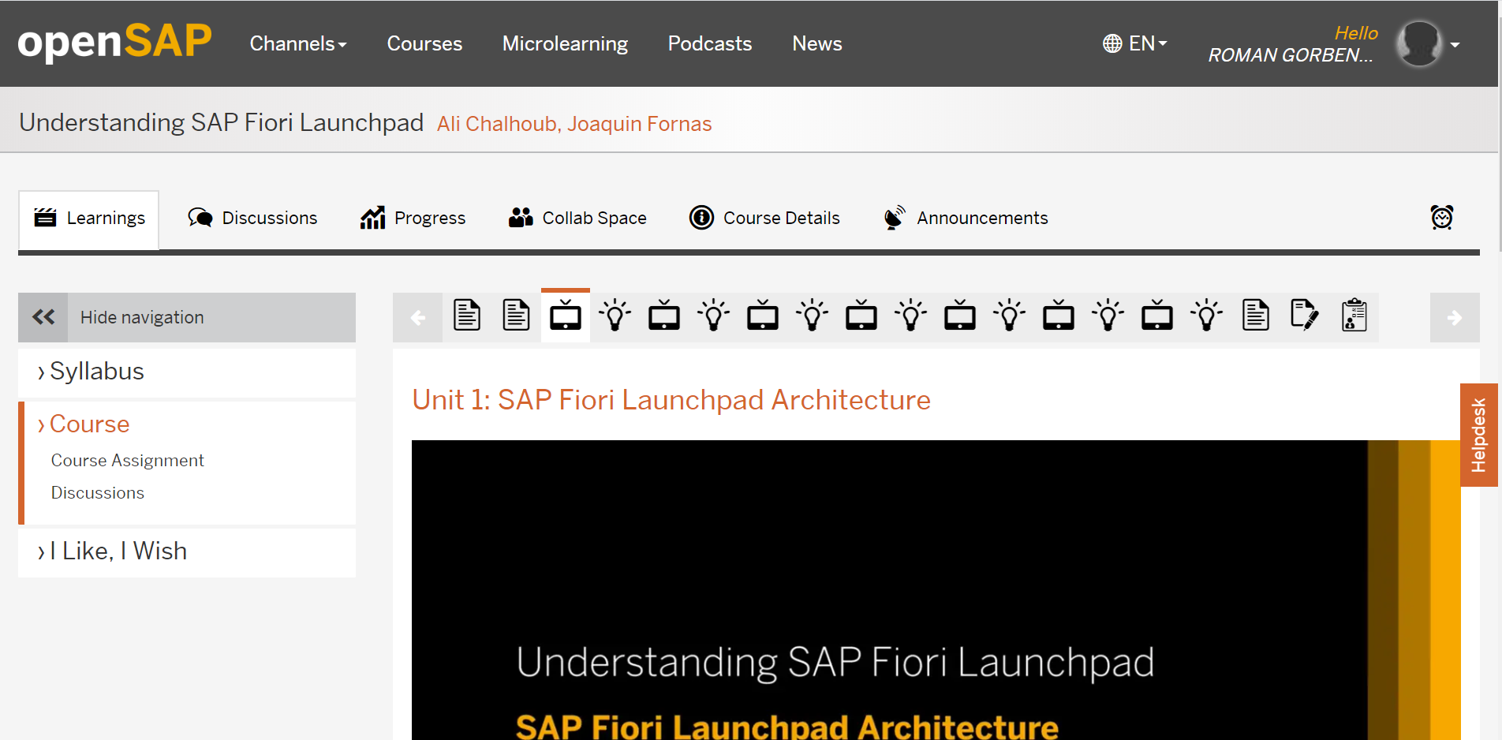
HOW TO INSTALL YOUR OWN SAP SYSTEM IN THE POPULAR CLOUDS
Become FIORI Developer. openSAP courses* and hands-on exercises in your own SAP system
- https://open.sap.com/courses/hsha1

Slide 46
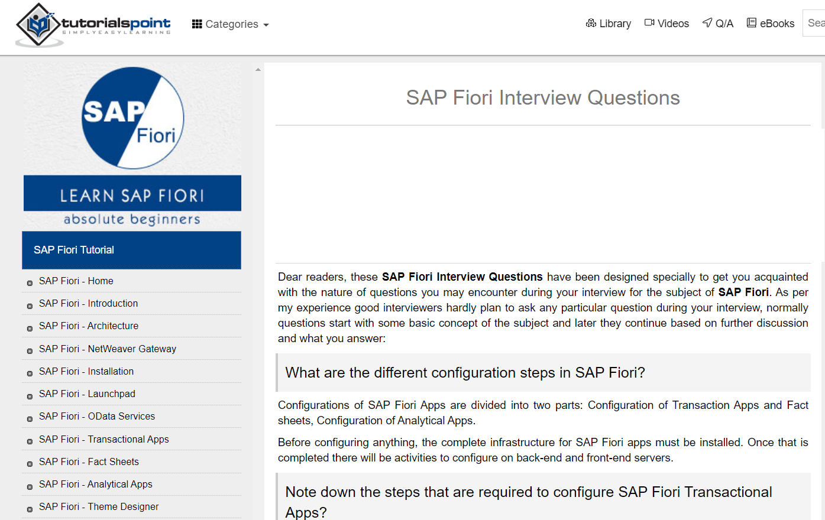
HOW TO INSTALL YOUR OWN SAP SYSTEM IN THE POPULAR CLOUDS
Become FIORI Developer. Prepare for the Job-interview* in your own SAP system
* - https://www.tutorialspoint.com/sap_fiori/sap_fiori_interview_questions.htm

Slide 47
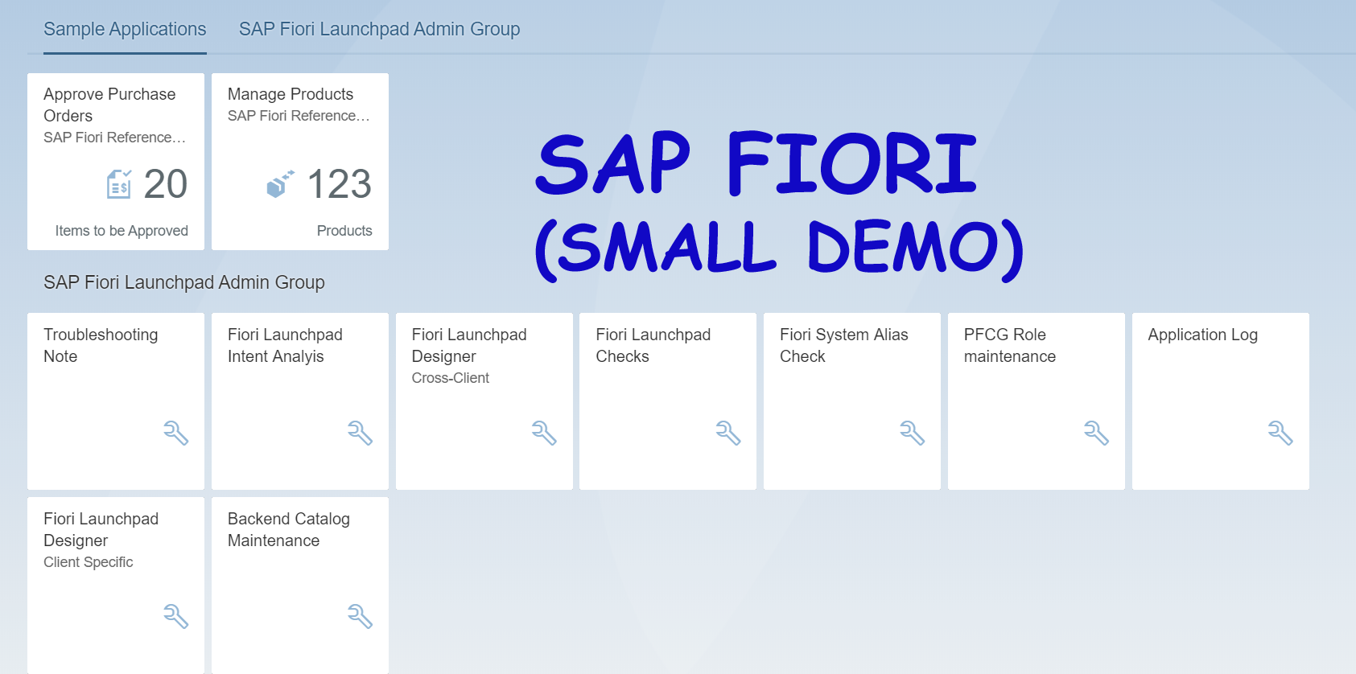
HOW TO INSTALL YOUR OWN SAP SYSTEM IN THE POPULAR CLOUDS
Become FIORI Developer

Slide 48
HOW TO INSTALL YOUR OWN SAP SYSTEM IN THE POPULAR CLOUDS
Become FIORI Developer.
Key transactions from video.
SICF - HTTP Service Hierarchy Maintenance
/UI2/FLP - SAP Fiori Launchpad

Slide 49
HOW TO INSTALL YOUR OWN SAP SYSTEM IN THE POPULAR CLOUDS
Key benefits: It is your own SAP system and you have a full (SAP_ALL) rights and preconfigured UI-services
Look at more FIORI examples after SAP system installation in Yandex Cloud. See you there!

Slide 50
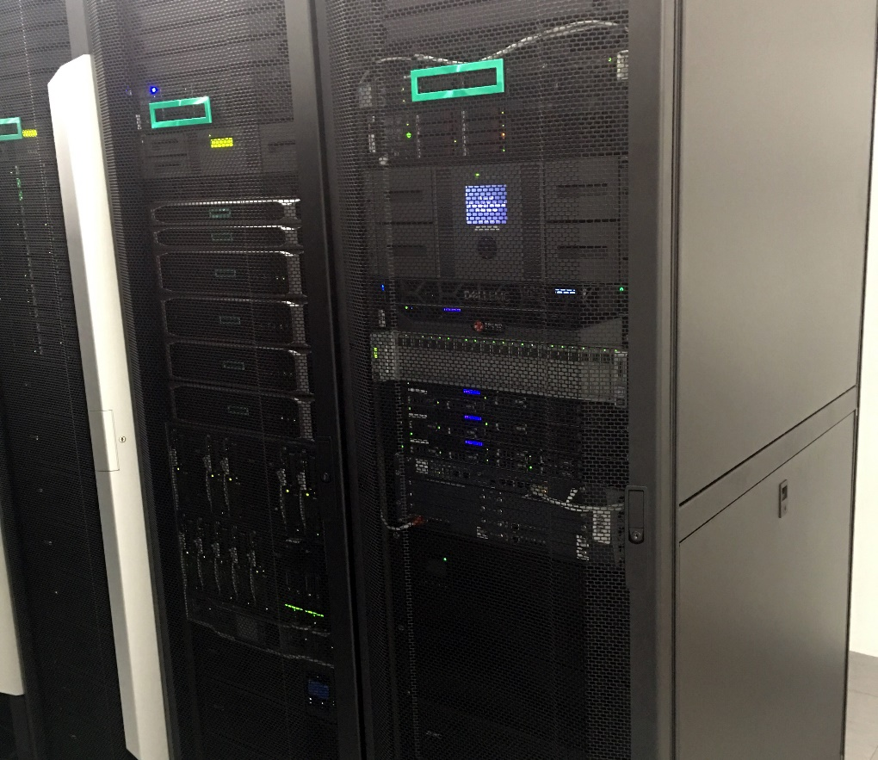
HOW TO INSTALL YOUR OWN SAP SYSTEM IN THE POPULAR CLOUDS
Become SAP BASIS Administrator

Slide 51
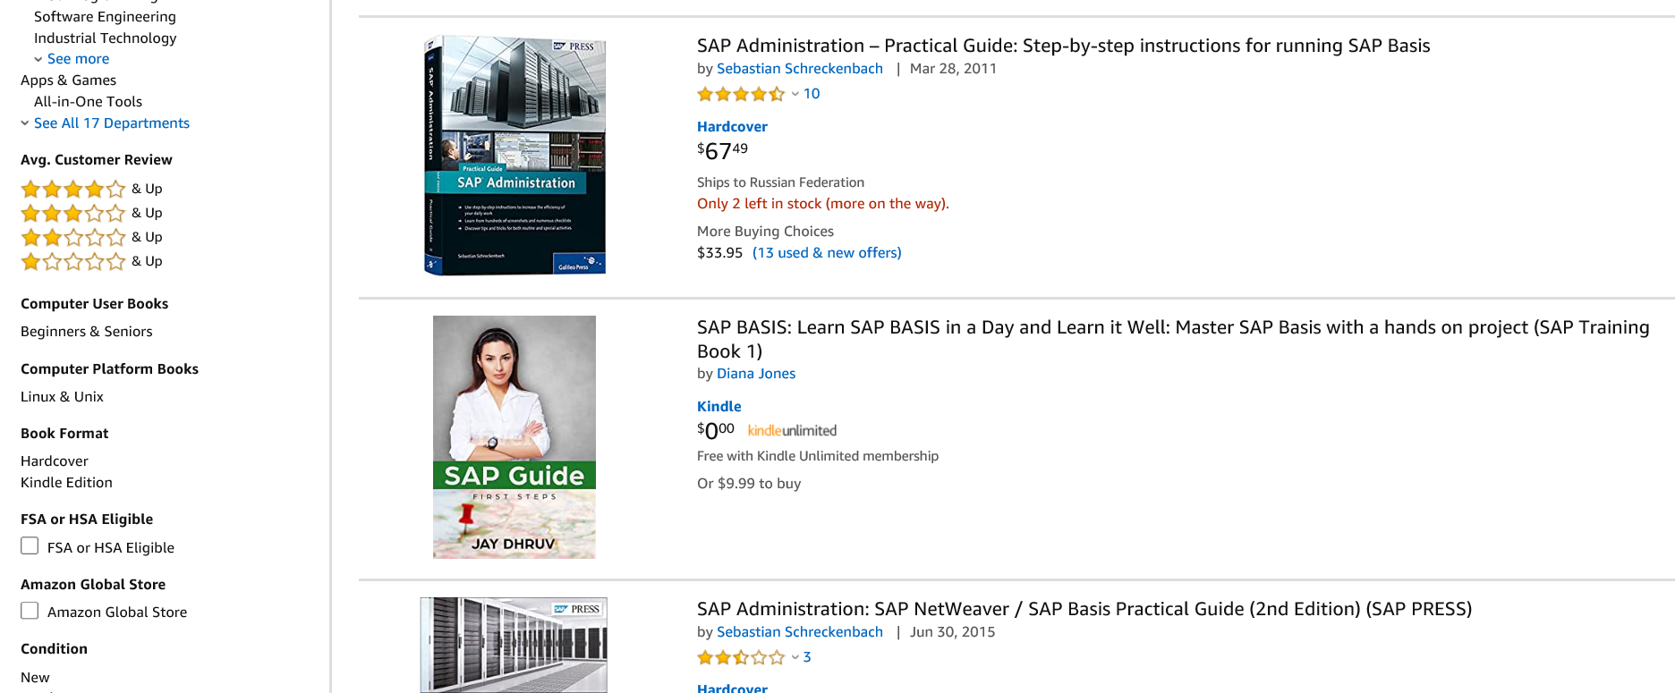
HOW TO INSTALL YOUR OWN SAP SYSTEM IN THE POPULAR CLOUDS
Become SAP BASIS Administrator.
Books* and hands-on exercises in your own SAP system
- https://www.amazon.com/s?k=sap+basis&ref=nb_sb_noss

Slide 52
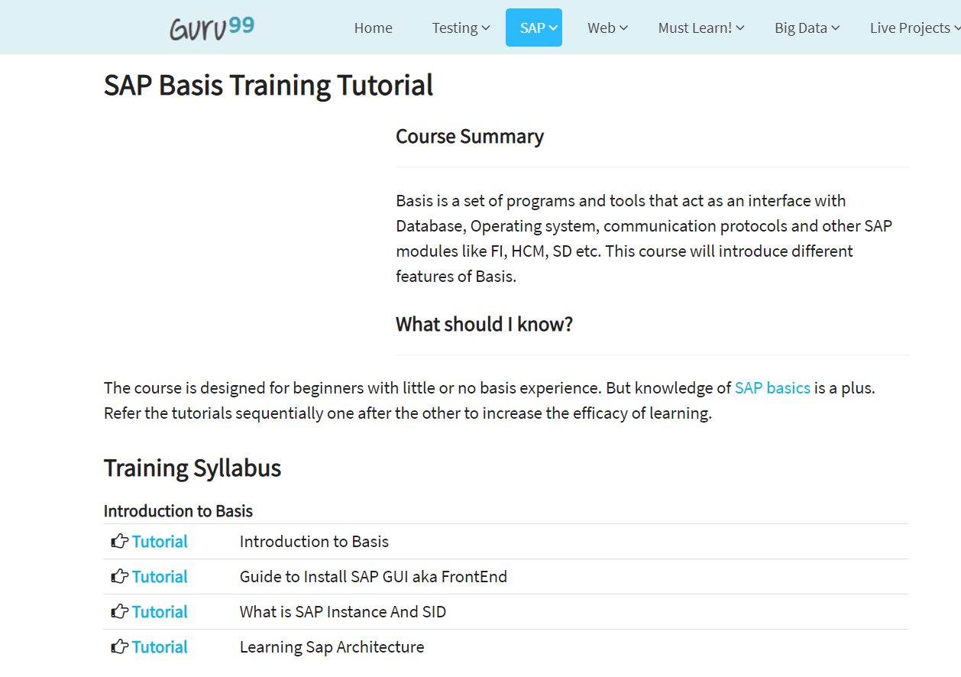
HOW TO INSTALL YOUR OWN SAP SYSTEM IN THE POPULAR CLOUDS
Become SAP BASIS Administrator.
Guides, Tutorials* and hands-on exercises in your own SAP system
* - https://www.guru99.com/sap-basis-training-tutorials.html

Slide 53
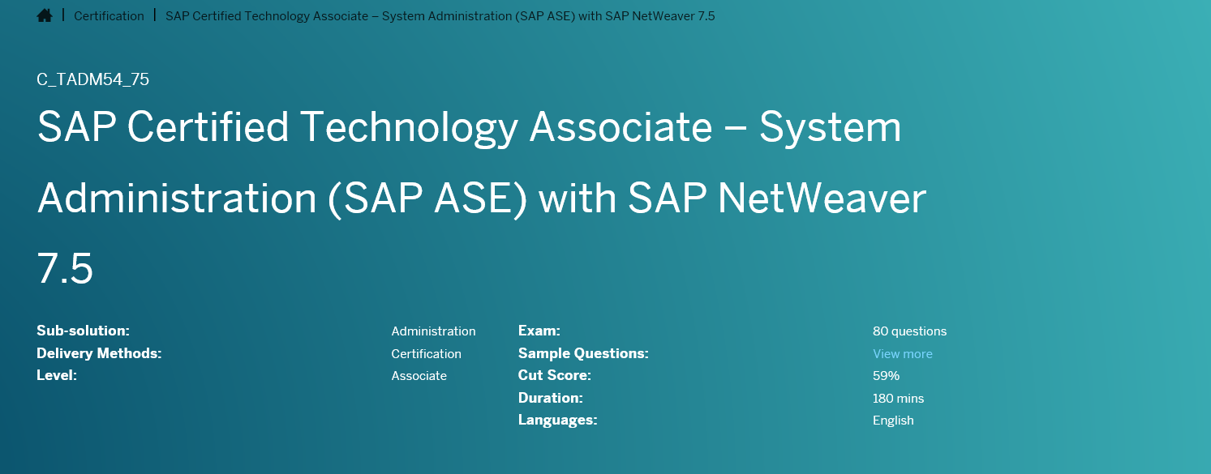
HOW TO INSTALL YOUR OWN SAP SYSTEM IN THE POPULAR CLOUDS
Become SAP BASIS Administrator.
To make your SAP System Administration Certification Exam (C_TADM*) preparation easy with hands-on exercises in your own SAP system
- https://training.sap.com/certification/c_tadm54_75-sap-certified-technology-associate--system-administration-sap-ase-with-sap-netweaver-75-g/

Slide 54
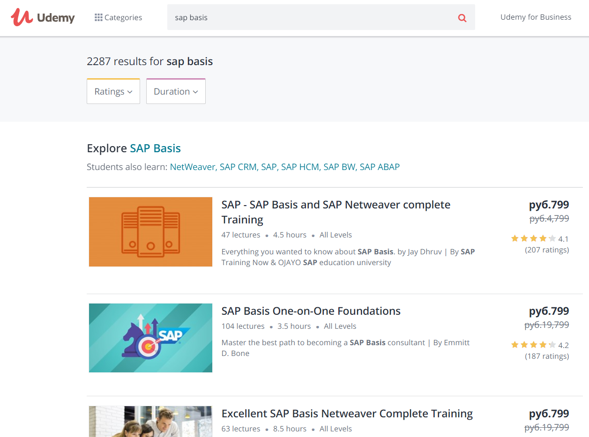
HOW TO INSTALL YOUR OWN SAP SYSTEM IN THE POPULAR CLOUDS
Become SAP BASIS Administrator.
Udemy courses* and hands-on exercises in your own SAP system
* - https://www.udemy.com/courses/search/?q=sap%20basis&src=sac&kw=basis

Slide 55
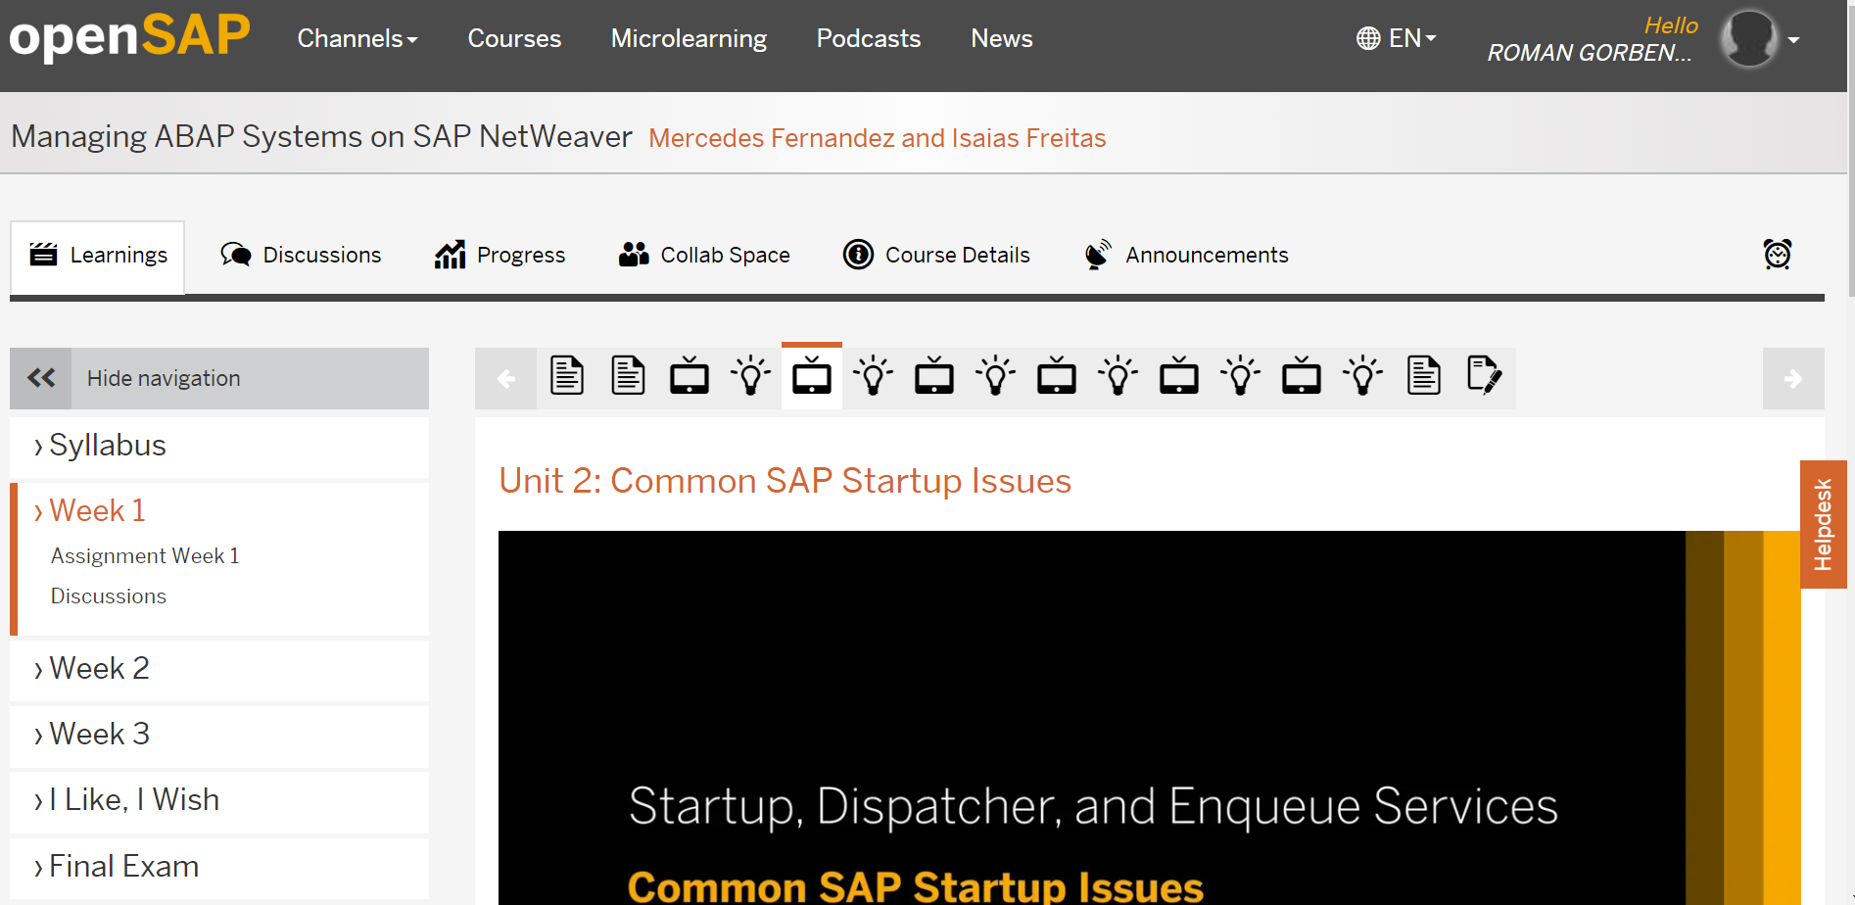
HOW TO INSTALL YOUR OWN SAP SYSTEM IN THE POPULAR CLOUDS
Become SAP BASIS Administrator.
openSAP courses* and hands-on exercises in your own SAP system
* - https://open.sap.com/courses/cst1/items/6SfKONnipmZjtTeTwpWLq2

Slide 56
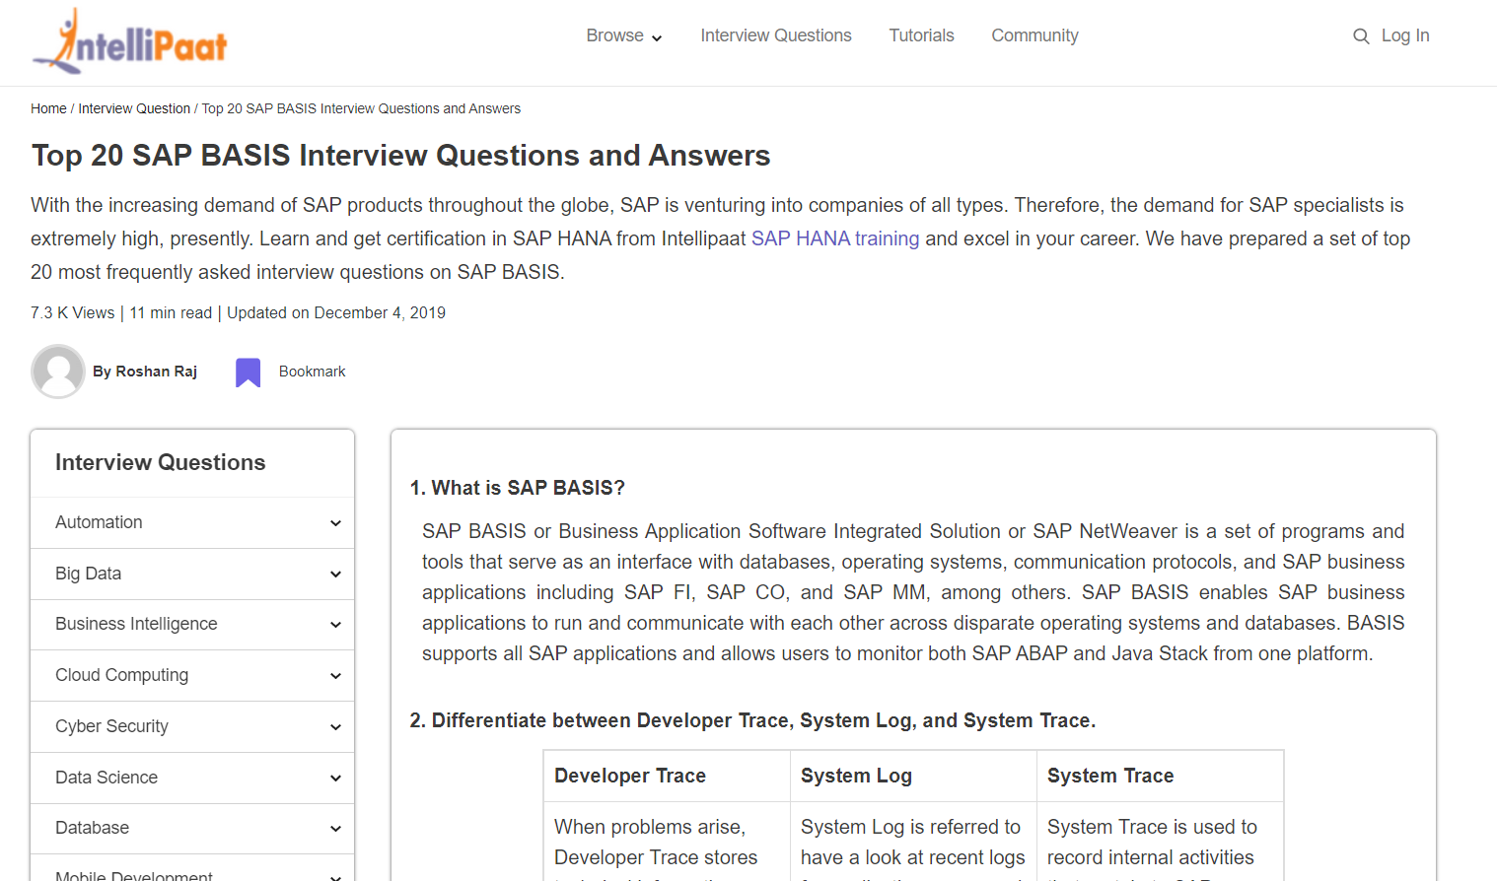
HOW TO INSTALL YOUR OWN SAP SYSTEM IN THE POPULAR CLOUDS
Become SAP BASIS Administrator.
Prepare for the Job-interview* in your own SAP system
* - https://intellipaat.com/blog/interview-question/sap-basis-interview-questions-and-answers/

Slide 57
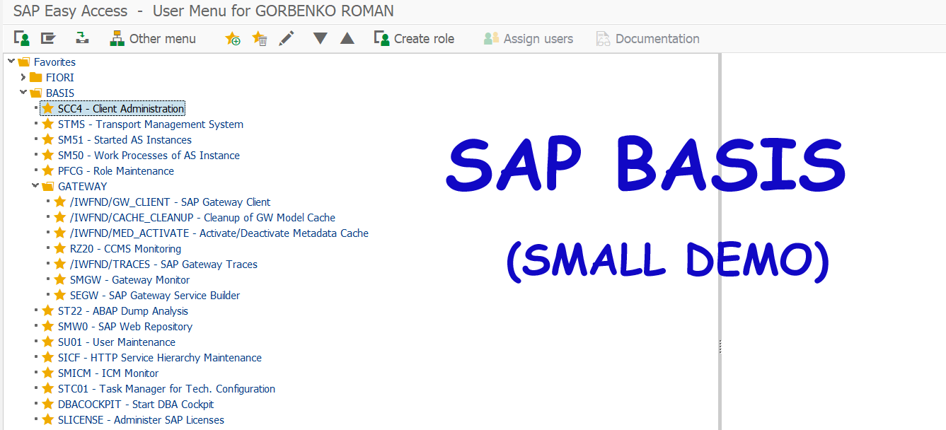
HOW TO INSTALL YOUR OWN SAP SYSTEM IN THE POPULAR CLOUDS
Become SAP BASIS Administrator

Slide 58
HOW TO INSTALL YOUR OWN SAP SYSTEM IN THE POPULAR CLOUDS
Become SAP BASIS Administrator.
Key transactions from video.
SCC4 - Client Administration
SE03 – Transport Organizer Tool
RZ10, RZ11 - Maintain profile parameters
SM36 - Schedule Background Job
SM37 - Overview of Job Selection
PFCG - Role Maintenance
SU01 - User Maintenance
SU53 - User Evaluate Authorization Check
SM04 - Logons to Application Server Instance
STMS - Transport Management System
SE09 – Transport Organizer

Slide 59
HOW TO INSTALL YOUR OWN SAP SYSTEM IN THE POPULAR CLOUDS
Key benefits: It is your own SAP system and you have a full (SAP_ALL) rights for your BASIS tasks
Look at more typical BASIS tasks examples after SAP system installation in Microsoft Azure Cloud. See you there!

Slide 60
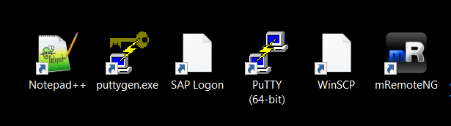
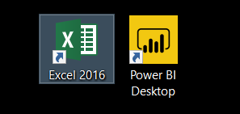
HOW TO INSTALL YOUR OWN SAP SYSTEM IN THE POPULAR CLOUDS
Tools overview
Сценарий для короткого видео:
Notepad++, PuTTY and PuTTYgen, Sap Logon, WinSCP, mRemoteNG
Optional tools: Microsoft Excel, Power BI Desktop

Slide 61
HOW TO INSTALL YOUR OWN SAP SYSTEM IN THE POPULAR CLOUDS
Tools overview
Notepad++ is a free editor and Windows Notepad replacement that supports several languages. Running in the MS Windows environment, its use is governed by GPL License.
* - https://notepad-plus-plus.org/ (free)

Slide 62
HOW TO INSTALL YOUR OWN SAP SYSTEM IN THE POPULAR CLOUDS
Tools overview
PuTTY is an SSH and telnet client, developed originally by Simon Tatham for the Windows platform. PuTTY is open source software that is available with source code and is developed and supported by a group of volunteers.
* - https://www.putty.org/ (free)

Slide 63
HOW TO INSTALL YOUR OWN SAP SYSTEM IN THE POPULAR CLOUDS
Tools overview
PuTTYgen is a key generator tool for creating pairs of public and private SSH keys. It is one of the components of the open-source networking client PuTTY. Although originally written for Microsoft Windows operating system, it is now officially available for multiple operating systems including macOS, Linux. PuTTYgen.exe is the graphical tool on Windows OS
* - https://www.puttygen.com/ (free)

Slide 64
HOW TO INSTALL YOUR OWN SAP SYSTEM IN THE POPULAR CLOUDS
Tools overview
WinSCP is a popular SFTP client and FTP client for Microsoft Windows! Copy file between a local computer and remote servers using SFTP file transfer protocols.
* - https://winscp.net/eng/index.php (free)

Slide 65
HOW TO INSTALL YOUR OWN SAP SYSTEM IN THE POPULAR CLOUDS
Tools overview
mRemoteNG is a fork of mRemote: an open source, tabbed, multi-protocol, remote connections manager. mRemoteNG supports the following protocols:
RDP (Remote Desktop/Terminal Server)
VNC (Virtual Network Computing)
ICA (Citrix Independent Computing Architecture)
SSH (Secure Shell)
Telnet (TELecommunication NETwork)
* - https://mremoteng.org/ (free)

Slide 66
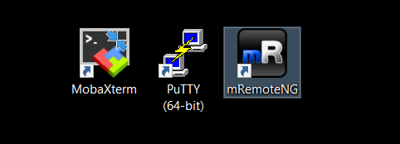
HOW TO INSTALL YOUR OWN SAP SYSTEM IN THE POPULAR CLOUDS
Tools overview
MobaXterm - is an enhanced terminal for Windows with an X11 server, a tabbed SSH client and several other network tools for remote computing (VNC, RDP, telnet, rlogin). MobaXterm brings all the essential Unix commands to Windows desktop, in a single portable exe file which works out of the box
- https://mobaxterm.mobatek.net/

Slide 67
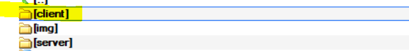
HOW TO INSTALL YOUR OWN SAP SYSTEM IN THE POPULAR CLOUDS
Tools overview
SAP Logon - is the GUI Front End client in SAP 3-tier architecture of database, application server and client. It is software that runs on a Microsoft Windows and other platforms, and allows a user to access SAP functionality.
Location: Client folder in SAP NetWeaver Application Server ABAP 7.5X Developer Edition installation media

Slide 68
HOW TO INSTALL YOUR OWN SAP SYSTEM IN THE POPULAR CLOUDS
Tools overview. Optional tools
Microsoft Excel - The BEx analyzer is an analysis based reporting and designing tool embedded with Microsoft Excel which can be used to the analyze data in the InfoProvider. We use this tool in the section Become SAP BI / BW Developer
* - https://products.office.com/en-us/excel (trial)

Slide 69
HOW TO INSTALL YOUR OWN SAP SYSTEM IN THE POPULAR CLOUDS
Tools overview. Optional tools
Microsoft Power BI Desktop - Power BI is a business analytics service by Microsoft. It aims to provide interactive visualizations and business intelligence capabilities with an interface simple enough for end users to create their own reports and dashboards. Power BI can connect to SAP BW application server (cubes, Bex queries) and can be on top of SAP Data sources. We use this tool in the section Become SAP BI / BW Developer
* - https://powerbi.microsoft.com/en-us/desktop/ (free)

Slide 70

HOW TO INSTALL YOUR OWN SAP SYSTEM IN THE POPULAR CLOUDS
Tools overview

Slide 71
HOW TO INSTALL YOUR OWN SAP SYSTEM IN THE POPULAR CLOUDS
Where you can install your own SAP system?
AWS
YANDEX
…
AZURE
GCP

Slide 72




HOW TO INSTALL YOUR OWN SAP SYSTEM IN THE POPULAR CLOUDS
Where you can install your own SAP system?

Slide 73
HOW TO INSTALL YOUR OWN SAP SYSTEM IN THE POPULAR CLOUDS
Amazon AWS

Slide 74
HOW TO INSTALL YOUR OWN SAP SYSTEM IN THE POPULAR CLOUDS
Amazon AWS
Amazon Web Services (AWS) is a secure cloud services platform, offering compute power, database storage, content delivery and other functionality.
Some of the key services related to our course.
Basic Terminologies
Region — A region is a geographical area. Each region consists of 2 (or more) availability zones.
Availability Zone — It is simply a data center.
Edge Location — They are CDN (Content Delivery Network) endpoints for CloudFront.
Compute
EC2 (Elastic Compute Cloud) — These are just the virtual machines in the cloud on which you have the OS level control. You can run whatever you want in them.
Storage
S3 (Simple Storage Service) — Storage service of AWS in which we can store objects like files, folders, images, documents, songs, etc.

Slide 75

HOW TO INSTALL YOUR OWN SAP SYSTEM IN THE POPULAR CLOUDS
Amazon AWS

Slide 76
HOW TO INSTALL YOUR OWN SAP SYSTEM IN THE POPULAR CLOUDS
Amazon AWS

Slide 77

HOW TO INSTALL YOUR OWN SAP SYSTEM IN THE POPULAR CLOUDS
Amazon AWS
Links and Linux commands in a plain text
https://github.com/basisteam-io/BasisTeam-Content/blob/master/edu/sap_nw_in_cloud/aws.txt

Slide 78

HOW TO INSTALL YOUR OWN SAP SYSTEM IN THE POPULAR CLOUDS
Amazon AWS

Slide 79

HOW TO INSTALL YOUR OWN SAP SYSTEM IN THE POPULAR CLOUDS
Amazon AWS

Slide 80
HOW TO INSTALL YOUR OWN SAP SYSTEM IN THE POPULAR CLOUDS
Google Cloud Platform

Slide 81
HOW TO INSTALL YOUR OWN SAP SYSTEM IN THE POPULAR CLOUDS
Google Cloud Platform
Google Cloud Platform (GCP), offered by Google, is a suite of cloud computing services that runs on the same infrastructure that Google uses internally for its end-user products, such as Google Search and YouTube. Alongside a set of management tools, it provides a series of modular cloud services including computing, data storage, data analytics and machine learning. Registration requires a credit card or bank account details.
Google Cloud Platform provides infrastructure as a service, platform as a service, and serverless computing environments.
Google lists over 90 products under the Google Cloud brand. Some of the key services related to our course

Slide 82
HOW TO INSTALL YOUR OWN SAP SYSTEM IN THE POPULAR CLOUDS
Google Cloud Platform
Google lists over 90 products under the Google Cloud brand. Some of the key services related to our course.
Compute
App Engine - Platform as a Service to deploy Java, PHP, Node.js, Python, Ruby and Go applications.
Compute Engine - Infrastructure as a Service to run Microsoft Windows and Linux virtual machines.
Kubernetes Engine (GKE).
Cloud Functions - Functions as a Service to run event-driven code written in Node.js, Python or Go.

Slide 83
HOW TO INSTALL YOUR OWN SAP SYSTEM IN THE POPULAR CLOUDS
Google Cloud Platform
Networking
VPC - Virtual Private Cloud for managing the software defined network of cloud resources.
Cloud Load Balancing - Software-defined, managed service for load balancing the traffic.
Cloud Armor - Web application firewall to protect workloads from DDoS attacks.
Management Tools
Stackdriver - Monitoring, logging, and diagnostics for applications on Google Cloud Platform and AWS.
Identity & Security
Cloud Identity - Single sign-on (SSO) service based on SAML 2.0 and OpenID.

Slide 84

HOW TO INSTALL YOUR OWN SAP SYSTEM IN THE POPULAR CLOUDS
Google Cloud Platform

Slide 85

HOW TO INSTALL YOUR OWN SAP SYSTEM IN THE POPULAR CLOUDS
Google Cloud Platform
Mobile Cloud Console Overview

Slide 86

HOW TO INSTALL YOUR OWN SAP SYSTEM IN THE POPULAR CLOUDS
Google Cloud Platform
Links and Linux commands in a plain text
https://github.com/basisteam-io/BasisTeam-Content/blob/master/edu/sap_nw_in_cloud/gcp.txt

Slide 87

HOW TO INSTALL YOUR OWN SAP SYSTEM IN THE POPULAR CLOUDS
Google Cloud Platform

Slide 88

HOW TO INSTALL YOUR OWN SAP SYSTEM IN THE POPULAR CLOUDS
Google Cloud Platform

Slide 89

HOW TO INSTALL YOUR OWN SAP SYSTEM IN THE POPULAR CLOUDS
BI/BW Developer. Extended example (Resources)
1. Understanding BW InfoCube Dimensions and Fact Table
https://www.brightworkresearch.com/sapplanning/2008/07/08/dp-bw-dimensions-and-fact-table/

Slide 90
HOW TO INSTALL YOUR OWN SAP SYSTEM IN THE POPULAR CLOUDS
BI/BW Developer. Extended example (Resources)
2. Mobile phone sales statistics (CSV example created for this course).
https://www.brightworkresearch.com/sapplanning/2008/07/08/dp-bw-dimensions-and-fact-table/

Slide 91
HOW TO INSTALL YOUR OWN SAP SYSTEM IN THE POPULAR CLOUDS
Yandex Cloud

Slide 92

HOW TO INSTALL YOUR OWN SAP SYSTEM IN THE POPULAR CLOUDS
Yandex Cloud
Yandex (“Russian Google”) is a multinational corporation specializing in Internet-related products and services, including transportation, search and information services, eCommerce, navigation, mobile applications, and online advertising. Yandex provides over 70 services in total. Yandex. Cloud (service was started in 2019) is a suite of cloud services that makes it fast and safe to get as much computing power as you need on a pay-as-you-go model. You access this computing power over the internet. Yandex. Cloud offers different categories of cloud resources, such as virtual machines, block storage, databases, etc. You can manage resources in each category using the web-based console.

Slide 93

HOW TO INSTALL YOUR OWN SAP SYSTEM IN THE POPULAR CLOUDS
Yandex Cloud

Slide 94

HOW TO INSTALL YOUR OWN SAP SYSTEM IN THE POPULAR CLOUDS
Yandex Cloud
Links and Linux commands in a plain text
https://github.com/basisteam-io/BasisTeam-Content/blob/master/edu/sap_nw_in_cloud/yandex.txt

Slide 95


HOW TO INSTALL YOUR OWN SAP SYSTEM IN THE POPULAR CLOUDS
Yandex Cloud

Slide 96

HOW TO INSTALL YOUR OWN SAP SYSTEM IN THE POPULAR CLOUDS
Yandex Cloud

Slide 97
HOW TO INSTALL YOUR OWN SAP SYSTEM IN THE POPULAR CLOUDS
Microsoft Azure

Slide 98
HOW TO INSTALL YOUR OWN SAP SYSTEM IN THE POPULAR CLOUDS
Microsoft Azure
Microsoft Azure is a cloud computing service created by Microsoft for building, testing, deploying, and managing applications and services through Microsoft-managed data centers. It provides software as a service (SaaS), platform as a service (PaaS) and infrastructure as a service (IaaS) and supports many different programming languages, tools and frameworks, including both Microsoft-specific and third-party software and systems.
Microsoft lists over 600 Azure services, of which some of them related to this course are covered below
Compute services
Virtual machines, infrastructure as a service (IaaS) allowing users to launch general-purpose Microsoft Windows and Linux virtual machines, as well as preconfigured machine images for popular software packages.
Most users run Linux on Azure, some of the many Linux distributions offered, including Microsoft's own Linux-based Azure Sphere.

Slide 99

HOW TO INSTALL YOUR OWN SAP SYSTEM IN THE POPULAR CLOUDS
Microsoft Azure

Slide 100

HOW TO INSTALL YOUR OWN SAP SYSTEM IN THE POPULAR CLOUDS
Microsoft Azure
Links and Linux commands in a plain text
https://github.com/basisteam-io/BasisTeam-Content/blob/master/edu/sap_nw_in_cloud/azure.txt

Slide 101

HOW TO INSTALL YOUR OWN SAP SYSTEM IN THE POPULAR CLOUDS
Microsoft Azure

Slide 102

HOW TO INSTALL YOUR OWN SAP SYSTEM IN THE POPULAR CLOUDS
Microsoft Azure

Slide 103
HOW TO INSTALL YOUR OWN SAP SYSTEM IN THE POPULAR CLOUDS
Conclusion
Cloud technologies have taken a new level in learning SAP. Hand-on exercises
well complement books and courses, help prepare for SAP-certification and job-interviews.
This course focuses on the application level (SAP NetWeaver Platform)
For those who are interested in database level and especially the revolutionary SAP HANA XS DB welcome to the course "How to install your own SAP HANA XS EXPRESS EDITION database in the popular clouds "
See you there!
Time to sign-off. Adjos!

